Slide 1
Writing as a professional geologist
A staged research project designed for WAC by Dr. David Krantz, University of Toledo, College of Natural Sciences and Mathematics

Slide 2
WAC approaches in Geology courses
Sedimentology & Stratigraphy EEES 3220
is a required course for Geology majors
They usually take it sophomore or junior year
The WAC writing component includes
short, quick, low-stakes writing assignments
editing the writing of other students
self-reflection writing (1-2 pages)
topical essays (longer)
a lab report with interpretation & synthesis

Slide 3
Self reflection – thinking about the discipline
What is stratigraphy?
Answer the following questions without referring to the textbook
or any other reference.
What is stratigraphy as it relates to sediments and
sedimentary rocks?
What is the importance of stratigraphy to the subdisciplines
of Earth Science?
What is the importance of stratigraphy more broadly to the
Environmental Sciences?

Slide 4
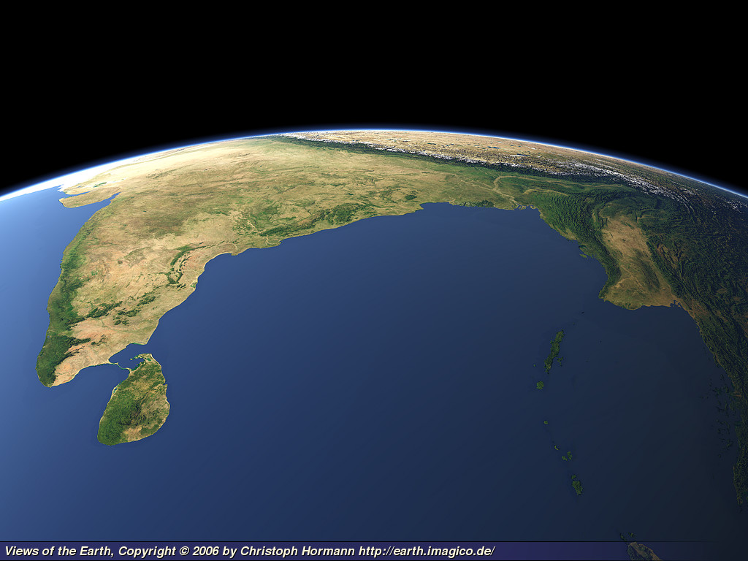
But India is really far older. In the days of the prehistoric ocean the southern part of the peninsula already existed, and the high places of Dravidia have been land since land began,
and have seen on the one side the sinking of a continent that joined them to Africa, and on the other the upheaval of the Himalayas from a sea.

Slide 5
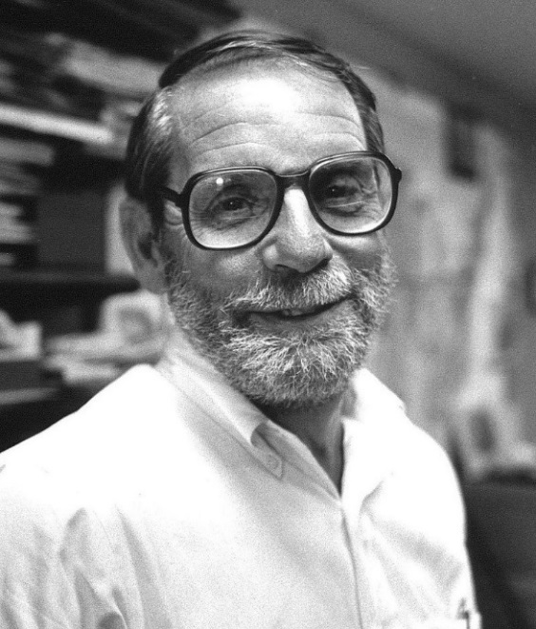
Examples from the masters
E.M. Forster 1924
A Passage to India
John McPhee 1989
The Control of Nature
Three essays, including
Los Angeles Against
the Mountains
(San Gabriel Mts.)

Slide 6
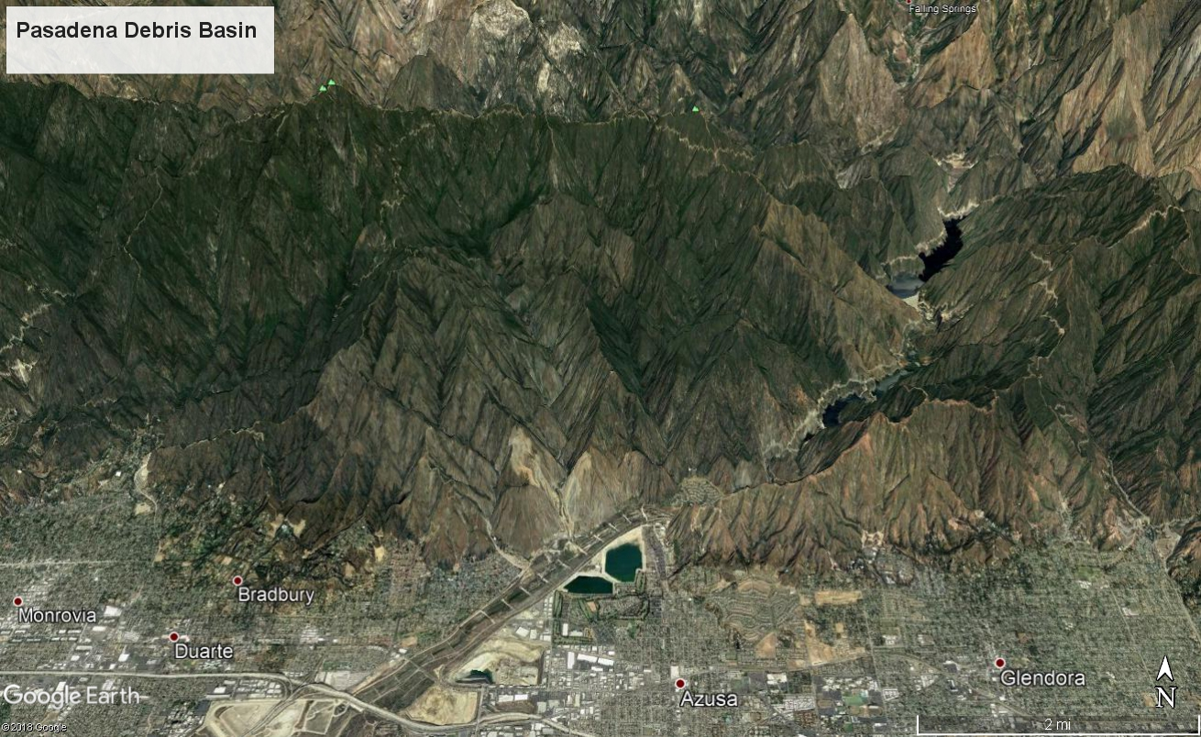
Writing as a professional geologist
Los Angeles Against the Mountains

Slide 7
Writing as a professional geologist
Los Angeles Against the Mountains
Written deposition submitted to a municipal
zoning commission
Assess the potential hazards from debris flows
to a proposed housing development

Slide 8
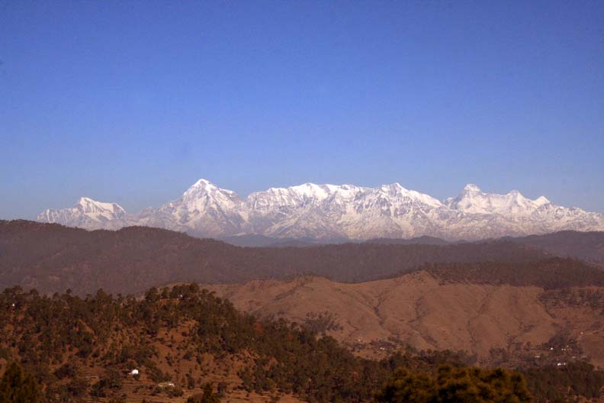
Tearing Down the Mountains
A topical essay, after presentation and discussion
in class.

Slide 9
Tearing Down the Mountains
A topical essay, after presentation and discussion
in class. Synthesis – late in the semester.
Context for the students:
Explain the main processes, starting with uplift of
the Himalayas, the forces of erosion, transport of
sediment by the Ganges-Brahmaputra River system,
deposition to form the Ganges Delta, and ultimately
burial in the deep ocean.

Slide 10
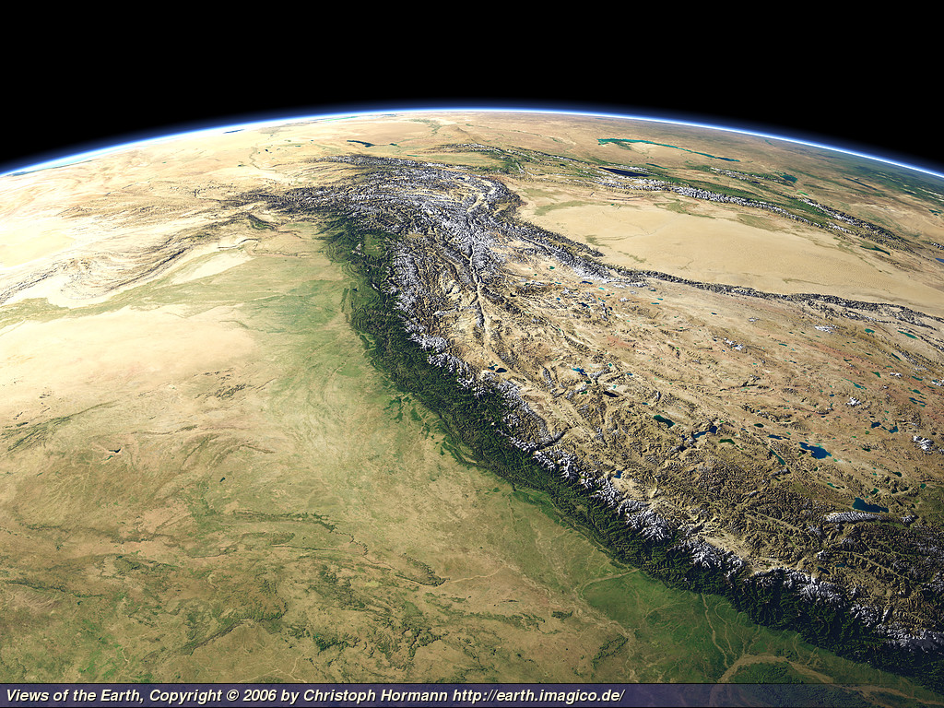
Collision of continents and regional uplift

Slide 11
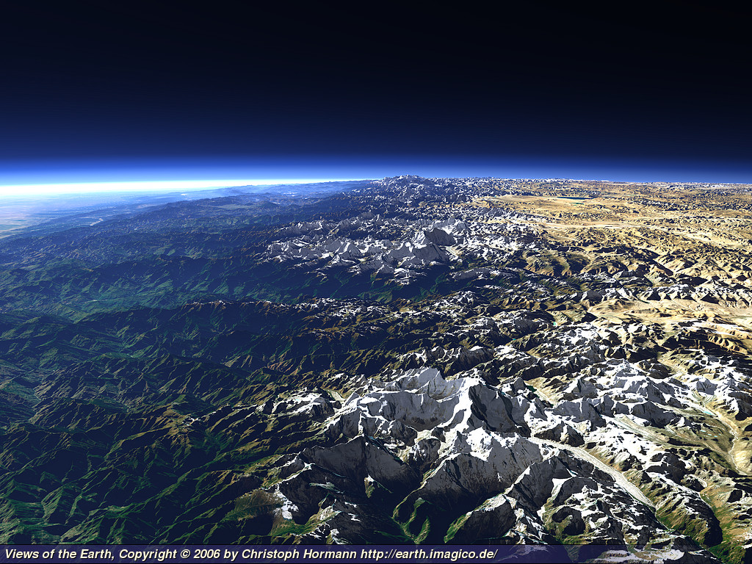
The Himalayan Front and Tibetan Plateau

Slide 12
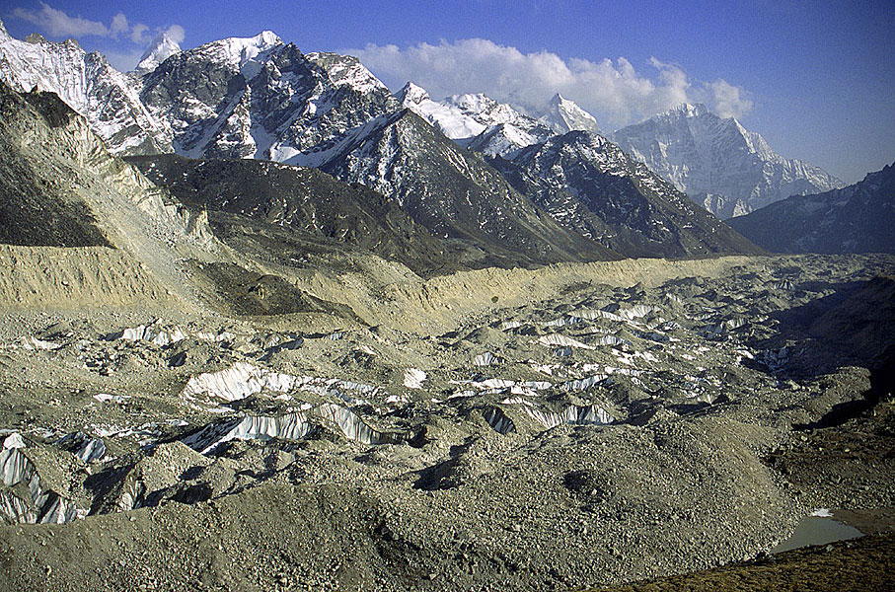
Erosion and transport by glaciers

Slide 13
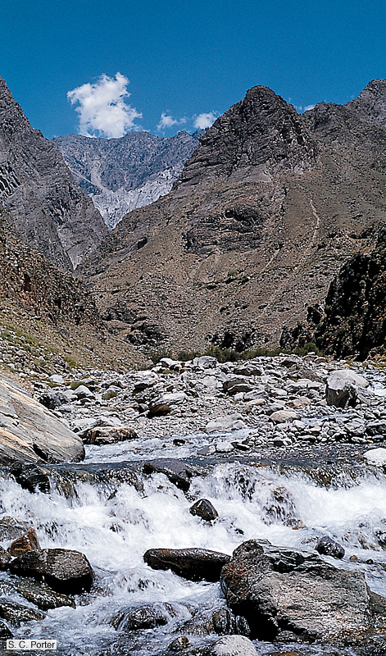
Erosion and transport
by rivers

Slide 14
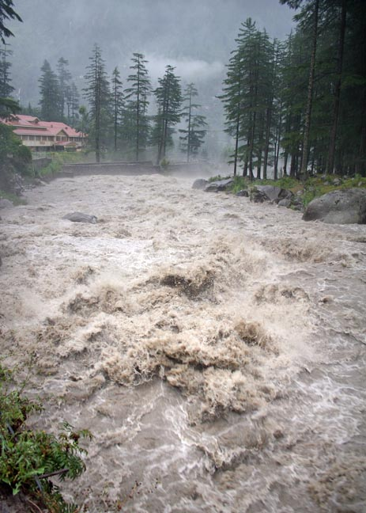
The scale of
forces involved

Slide 15
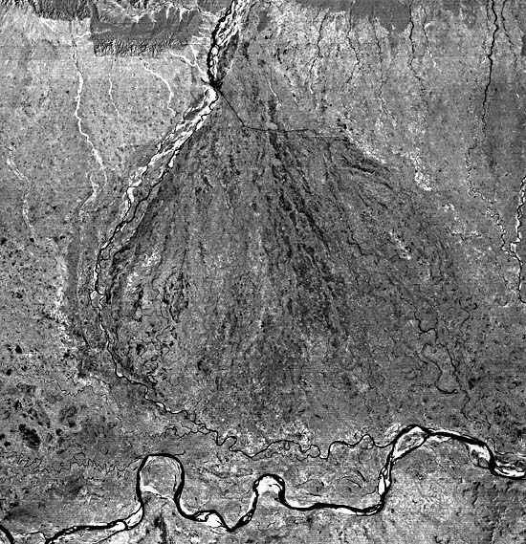
Megafan at base of Himalayas

Slide 16
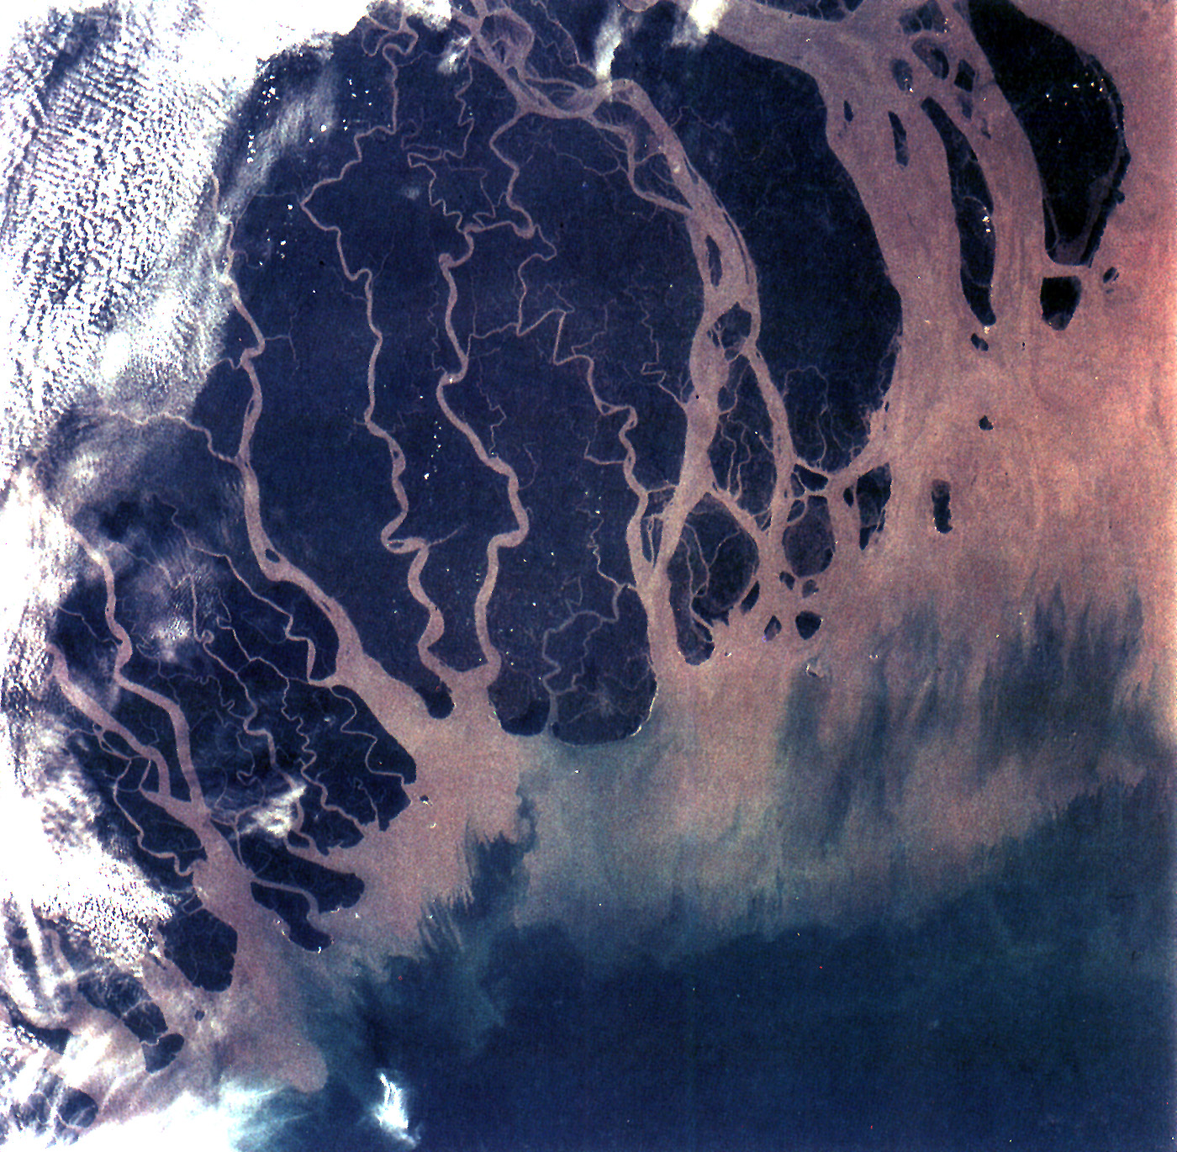
The Ganges Delta

Slide 17
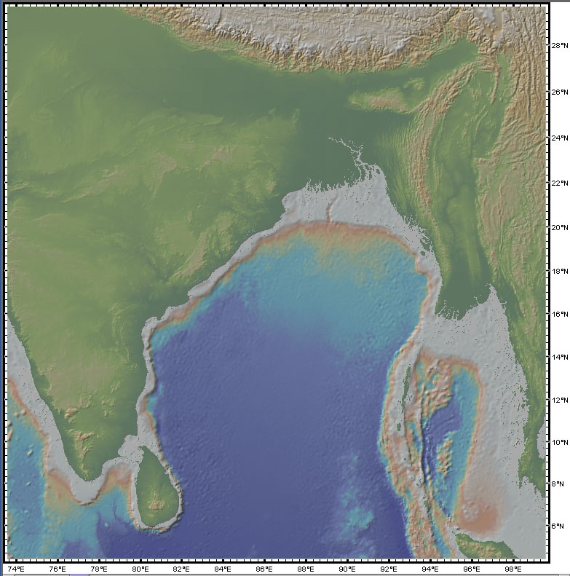
Ganges
Cone

Slide 18
The writing task
Students are given the PowerPoint presentation
and a set of instructions and suggestions.
The first draft is completely on their own.
After they turn in the first draft, I give them
an outline of the main geologic concepts
represented in the presentation.
They may then revise or refine their draft.

