Slide 1
UT’s Response to the Water Crisis
ODHE Regents Meeting
The University of Toledo
May 11, 2016

Slide 2

The Water Crisis
August 2, 2014 3 AM email alert:
  Per Lucas County: A ban has been placed on tap water in Lucas County for the time being. This includes any precautions normally taken.
Nearly ½ million people affected for two days—not to drink, brush teeth, wash pets, not to boil etc.—a story of international interest
Medical procedures rescheduled, food destroyed, events cancelled, emergency water supplies provided

Slide 3
UT Directly Affected
Closing and re-opening the university
  Closed 11 a.m. Saturday to 6 p.m. Sunday
Hospital operations altered
Alternative water sources provided
  Tankers on-site quickly; efficient water distribution
Notification to University community
  Timely and regular communication with UT community

Slide 4
UT Response
Source of expertise to local community
Providing scientific information to public and media
Providing support to public officials and government
Leverage deep faculty expertise on water and Great Lakes Issues
Formation of the UT Water Task Force

Slide 5

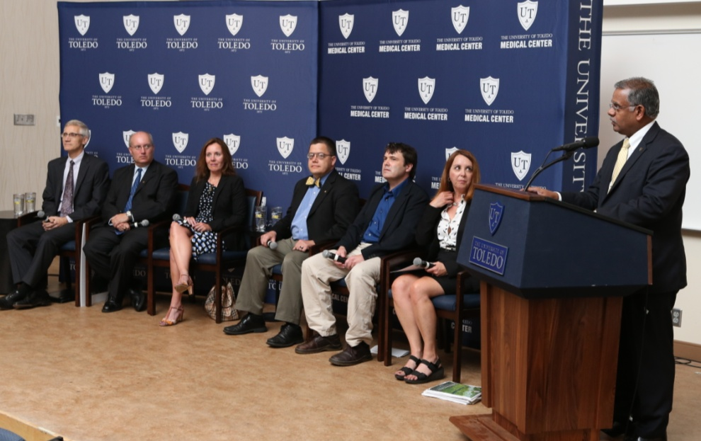
UT Water Forum – Aug. 5, 2014
A source of expertise for the public
  Attendance – ~250; On-line views - ~1,400

Slide 6
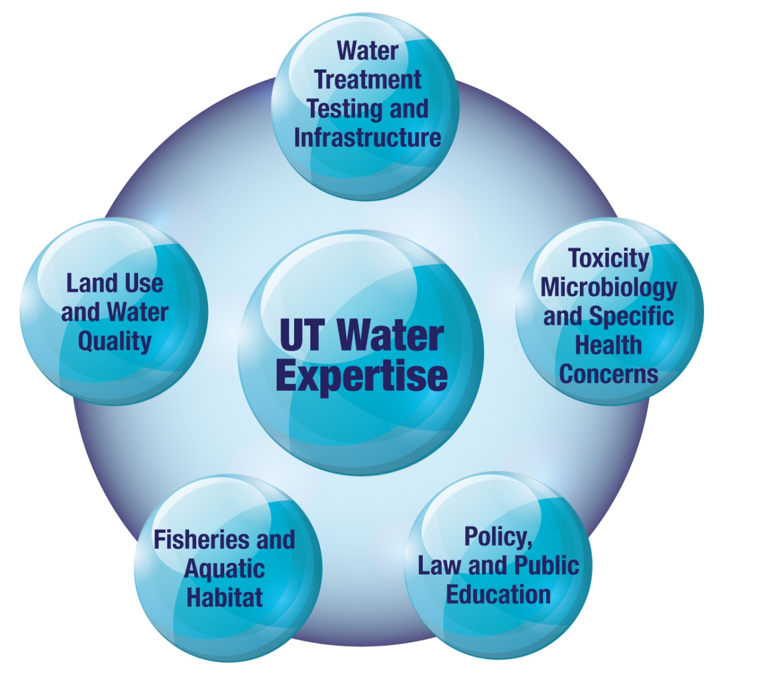
UT Colleges Leading Water Research Efforts:
Law
Business
Engineering
Natural Sciences & Mathematics
Languages, Literature & Social Sciences
Medicine
Nursing

Slide 7
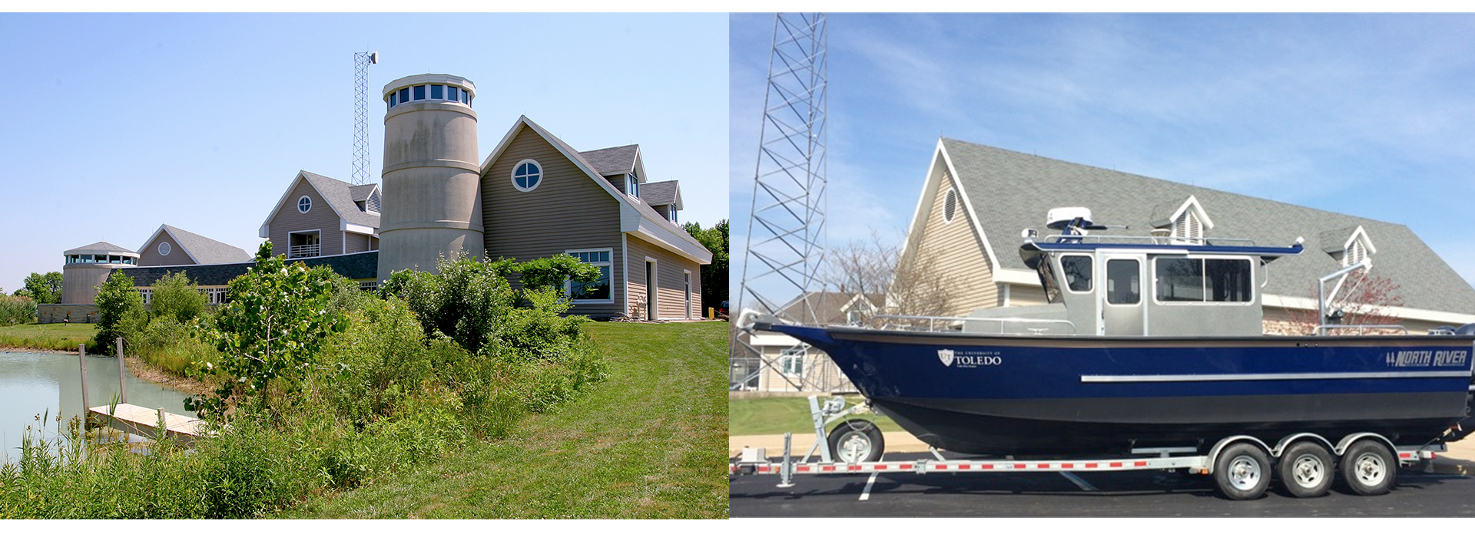
Lake Erie Center

Slide 8
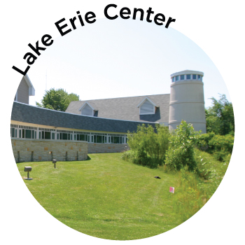
Land Use and Water Quality
Blooms
Great Lakes Ecology
Watershed Modeling
Remote Sensing/GIS
Wetlands (natural and constructed)
Notes:
LEC

Slide 9
Fisheries, Aquaculture and Aquatic Habitat
Habitat Health
Fisheries and Aquaculture
Fish diseases
Invasive Species
Notes:
Lake Erie Center

Slide 10
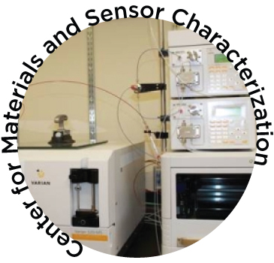
Water Treatment, Infrastructure, Testing, and Detection and Monitoring
Testing methods
Water treatment methods
Biofilms
Water distribution systems
Sensors
Pathogen control
Notes:
Center for Materials…

Slide 11

Policy, Economics, Law and Public Education
Economic Impact
Environmental Economics
Cost-benefit analysis
Law
Notes:
Legal institute of the LEC

Slide 12

Toxicity, Microbiology and Specific Health Concerns
Environmental Health
Exposure Assessment
Risk Assessment
Disease relationships
Toxicology

Slide 13
Co-Chaired Chancellor’s Higher Education Harmful Algal Bloom Research Initiative with OSU
Dr. Tom Bridgeman, UT Associate Professor of Environmental Sciences and co-Chair, Chancellor’s Higher Education Harmful Algal Bloom Research Initiative

Slide 14
UT Water Research Projects Supported by the Ohio Department of Higher Education
Focus Area
Blooms: Sources and Movements | $505,742 | $384,023 | $889,765
Produce Safe Drinking Water | $535,546 | $649,829 | $1,185,375
Protect Public Health | $226,429 | $458,256 | $684,685
Educate and Engage | $66,501 | $179,391 | $245,892
 | ODHE Funds | Matching Funds | Total
 | $1,334,218 | $1,671,499 | $3,005,717

Slide 15
Summary
Not just a state problem—a global challenge
Problem interdisciplinary--requires contributions from science, law, policy, medicine, engineering, and social sciences—UT contributing in all areas
Chancellor’s funding helped support many important projects across entire spectrum of problem
Continued state investment needed for university faculty to address complex problem

Slide 16
UT’s Response to the Water Crisis
ODHE Regents Meeting
The University of Toledo
May 11, 2016

Slide 17
HAB Detection, Mapping and Warning Network: Maumee Bay Area
PI (Thomas Bridgeman, Assoc. Prof)
Co-PI (Ricky Becker, Assoc. Prof)
$249,600 ODHE, NASA
Year 1 completed of 2 Year project

Slide 18

Objectives
Deploy buoy with sensors in Lake Erie to provide HAB early-warning for City of Toledo and Oregon.
Improve understanding of environmental causes of HAB and toxin development (temperature, sunlight, nutrients)
Improve remote sensing of HABs (collaboration with NOAA)
Outcomes to Date
Buoy purchased and deployed June-October 2015.
Weekly trips May-Oct to measure toxin near water intakes
Data collection during NASA overflights
Growing multi-organizational network of sensors
2016 Plan
Deploy buoy in May, weekly cruises in bloom season
NASA overflights
Improve data turnaround and delivery to users

Slide 19
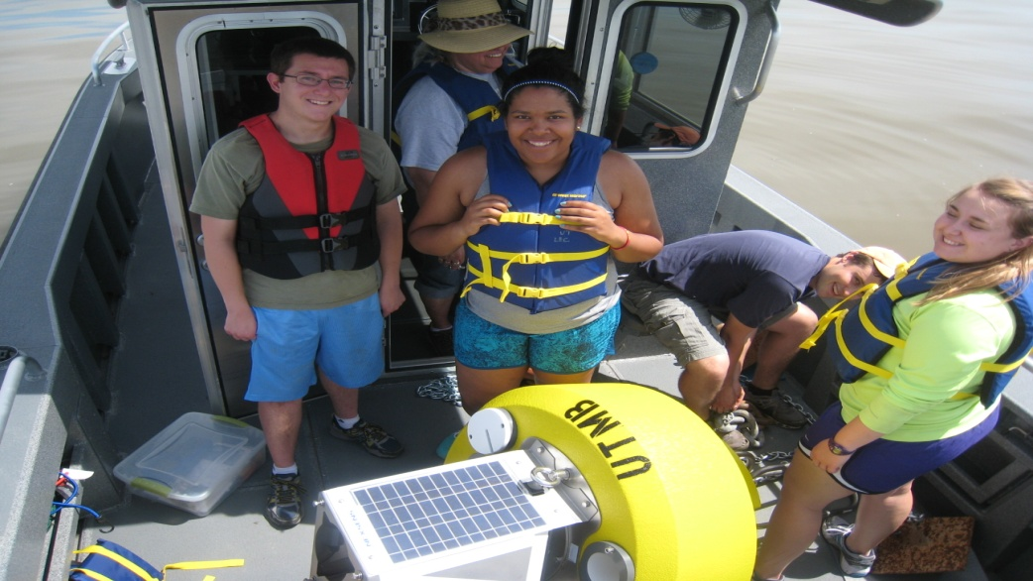
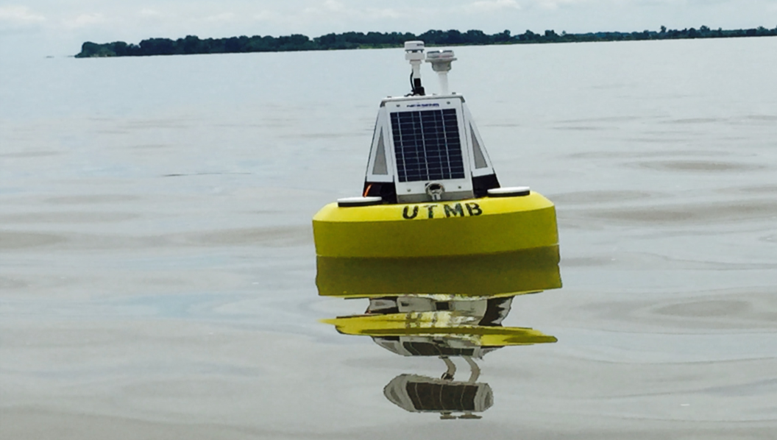
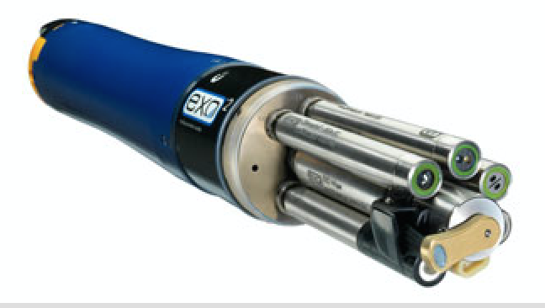
Maumee Bay Water Quality Buoy
YSI EXO measures:
green and blue algal pigments
pH, turbidity, temperature, conductivity,
Dissolved oxygen, depth
Notes:
Here’s our buoy along with the undergraduate and graduate students who helped to deploy it and maintain the sensors all summer long

Slide 20
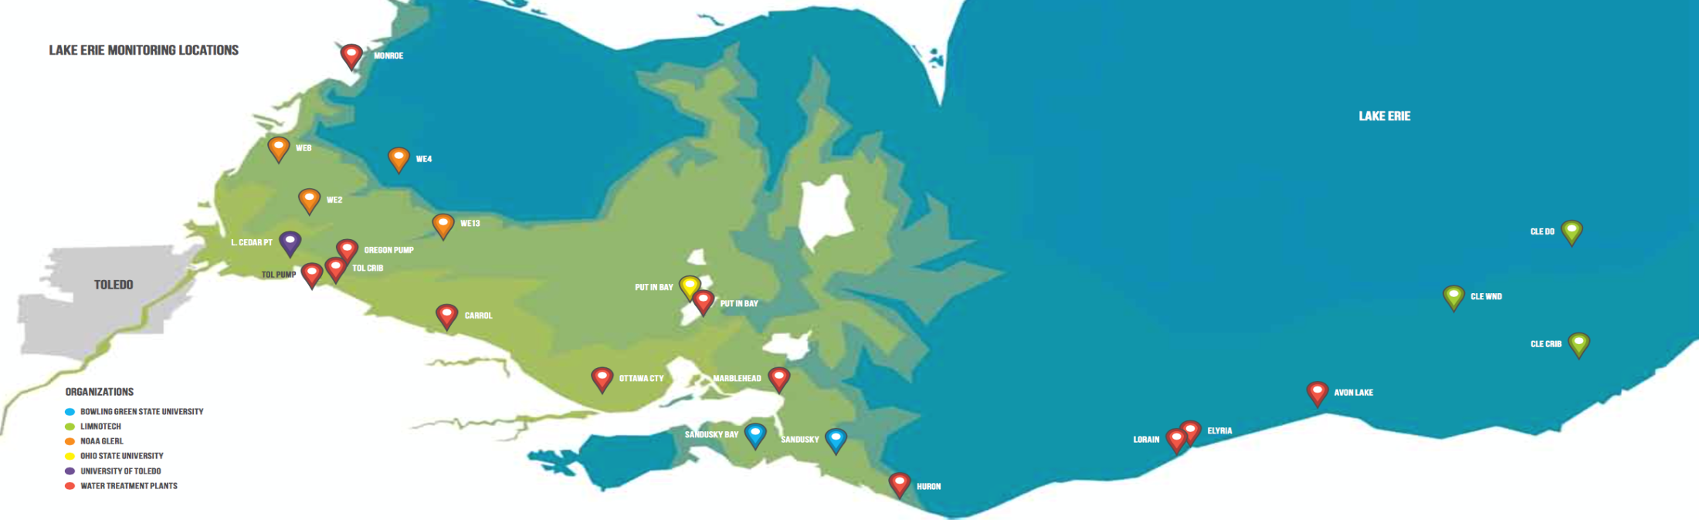
Water Quality Sensor Network
  10 Water utilities
  3 Ohio universities (UT, OSU, BGSU)
  NOAA
Environmental Monitor, 2015
Notes:
As I mentioned, Toledo is just part of what is becoming a network of sensors operated by water plants, universities, and NOAA.
We are all working together on this and the central location for data right now is GLOS.
What we envision is a system in which instead of going to individual sites to see the data, you would be able to look at a map like this and tell where the bloom is and which way it is moving by noting which sites are ‘lit up’. It could even be animated like a ‘maps in motion’ weather map. NOAA has something like this now with their ‘HAB tracker’, but it is driven by models, not by actual data.

Slide 21
HAB Avoidance:
Vertical Movement of Harmful Algal Blooms in Lake Erie
PI Thomas Bridgeman
Co-I: Ricky Becker (UT)
George Bullerjahn, Mike McKay (BGSU)
Andrew Shepherd (Sinclair College)
Justin Chaffin (OSU)
Tim Davis, Steve Ruberg (NOAA-GLERL)
$169,000 ODHE, NOAA
Year 1 starting summer 2016

Slide 22
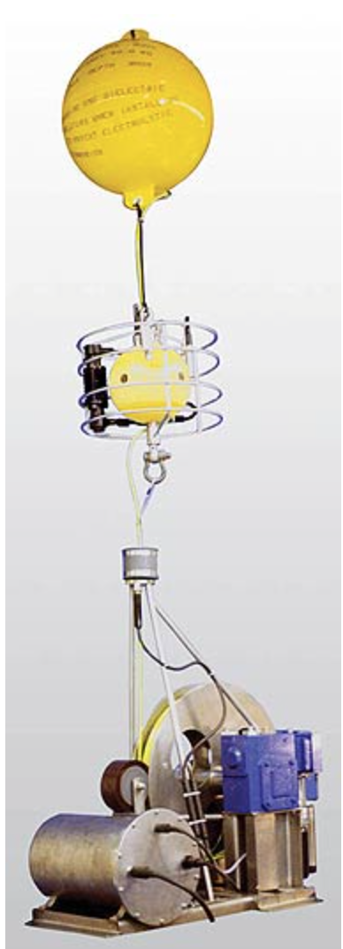
Objectives
Identify and understand the vertical distribution of HAB species and microcystin toxin as influenced by daily cycles and wind speed at a location near the Cities of Toledo and Oregon water intakes in Lake Erie
Advise water utilities on best times and conditions to increase or decrease water intake to minimize exposure to HABs
Outcomes to Date
Collaboration formed with NOAA, OSU, BGSU and Sinclair College.
2016 Plan
June, NOAA deploys profiling sensors at intake
August, 24-hr studies at intake locations

Slide 23
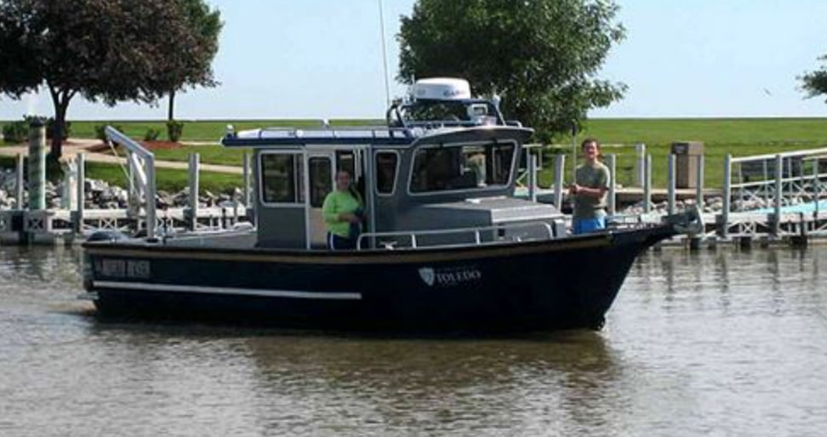

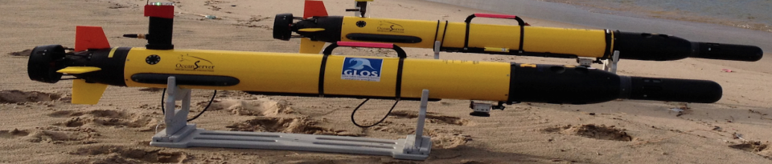
Project Features
24-hr boat based studies at Toledo Crib, South Bass Is. and NOAA location.
Continuous vertical profiling YSI at Toledo Crib (NOAA)
Horizontal and vertical tracking using AUV
Cyanobacterial DNA speciation (BGSU)
UAV (drone) deployment along shoreline (Sinclair College)
Notes:
There are several components to this project.
First, we will have at least 3 boats (UT, NOAA, OSU) in the water conducting 24-hr diel studies during the HAB to understand how HAB species migrate vertically at different locations during relatively calm periods.
Second, NOAA will be installing a YSI sonde on a vertically profiling system at the Toledo Crib that will record vertical profiles several times a day throughout the summer.
Third, NOAA will deploy AUVs (automated underwater vehicles) that will travel between the UT, NOAA, and OSU sites to profile both horizontal and vertical changes across a broad area.
Finally, BGSU will use samples collected on the boats to do DNA identification so we can know exactly which species we are dealing with.

Slide 24
How quickly can target phosphorus reductions be met? Robust predictions from multiple watershed and lake models
Collaborators:
Jay Martin (OSU)
Ricky Becker (UT)
Rem Confesor (Heidelberg)
Todd Redder (Limnotech)
Don Scavia (U of M)
Kumar Neduruni (Central State)
Dale Robertson (UGGS)

Slide 25
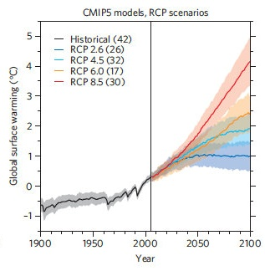
Objectives
Cross model comparison of 6 independently developed watershed runoff models (specifically for Phosphorous)
Determine how many years it will take to achieve 40% phosphorus load reduction
  Perform 30-year simulations of selected BMPs under
    Current climate
    Projected future climate scenarios
Range of global warming predictions, mild to severe

Slide 26
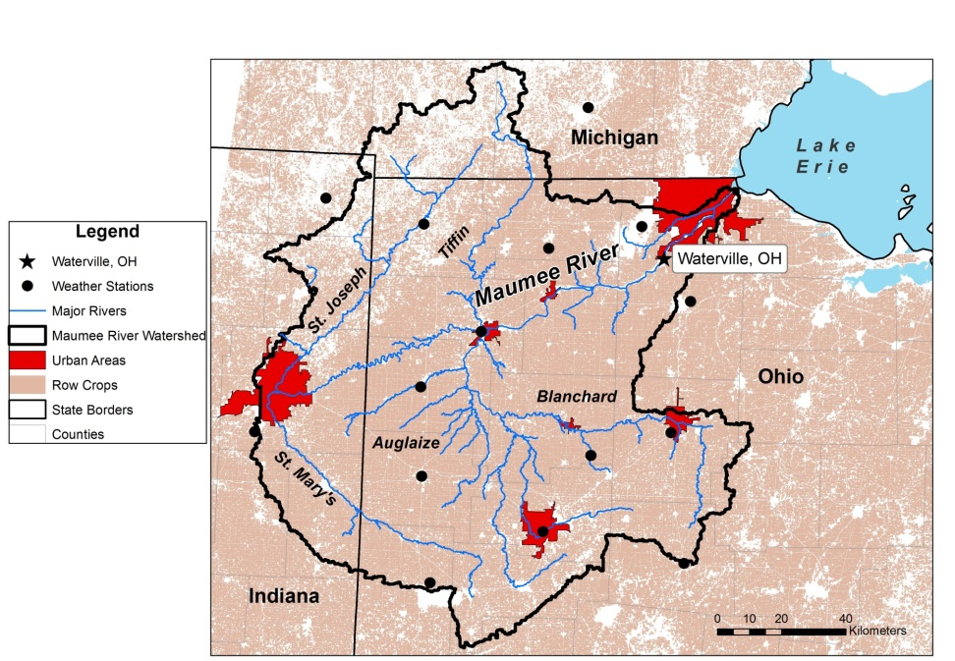
Objectives (Continued)
Determine the impacts of changes in future Maumee phosphorus loads upon water quality in Maumee Bay and Western Lake Erie using already validated lake models.
Identify alternate watershed management plans using stakeholder consultation, including individual and bundled BMPs with adoption rates.

Slide 27
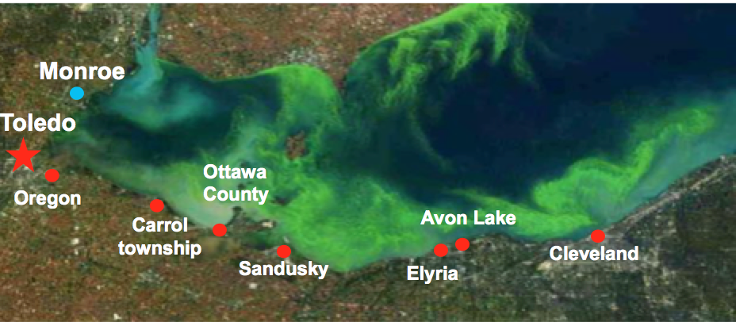
Investigation of Water Treatment Alternatives in the Removal of Microcystin-LR
R/SDW-2-BOR
Youngwoo (Young) Seo (UT)
Dionicious Dioniciou (UC)
Isabel Escobar (UK)
Toledo Water Treatment Plant
Bowling Green Water Treatment Plant
Notes:
Harmful algal blooms are not just a Toledo problem. There are water plants all along the Ohio shoreline that use Lake Erie as their source and are potentially affected by HABs

Slide 28
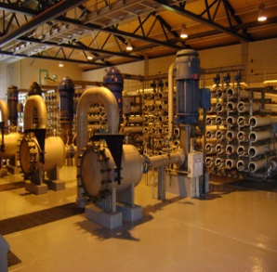
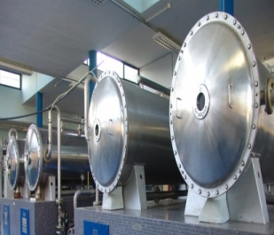
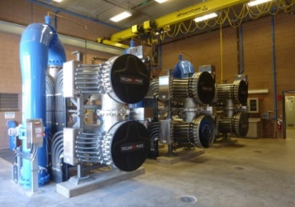
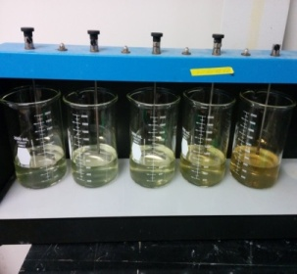
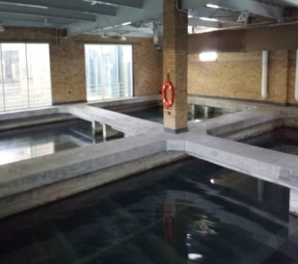
Objective:
Study alternative water treatment processes for the effective removal of algal toxins (5 related projects)
Membrane (UK)
Ozonation
(UK & UT)
UV/H2O2 (UC)
Potassium permanganate KMnO₄
Optimization (UT)
Biological Filtration (UT)
Notes:
There are many possible methods to remove algal toxins from a water source in order to prevent toxins from entering the drinking water supply. The most common methods-not shown here- are the addition of activated carbon to absorb toxins, and chlorine to break toxins down. But these methods have serious drawbacks in terms of expense, and byproducts. Therefore several Ohio universities have been investigating alternate methods of removing toxins. These methods range from membranes that block the passage of toxins (study at UK) to various methods of chemically ‘burning up’ toxins (ozonation at UK, UV/H2O2 at UC, and KMNO4 addition. Or toxins can be chewed up by microbes in the process of Biological filtration.
Today I’m focusing on these last two studies, that are being conducted in Youngwoo Seo’s lab at UT

Slide 29
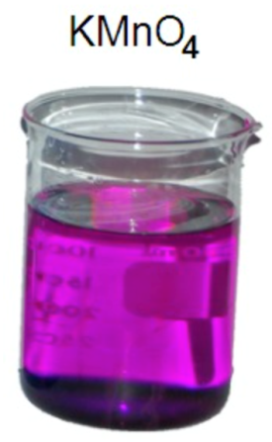
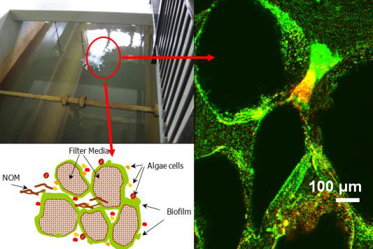
Objectives
KMnO₄ is the first line of defense against algal toxins.
  Determine the the optimal KMnO₄ dose (0.5, 1, 2, 4 or 8?) and contact time (1, 2, 3, or 4 hours?)
As a second line of defense, investigate the ability of biofilms in water treatment plants to remove algal toxins
Biofilms

Slide 30
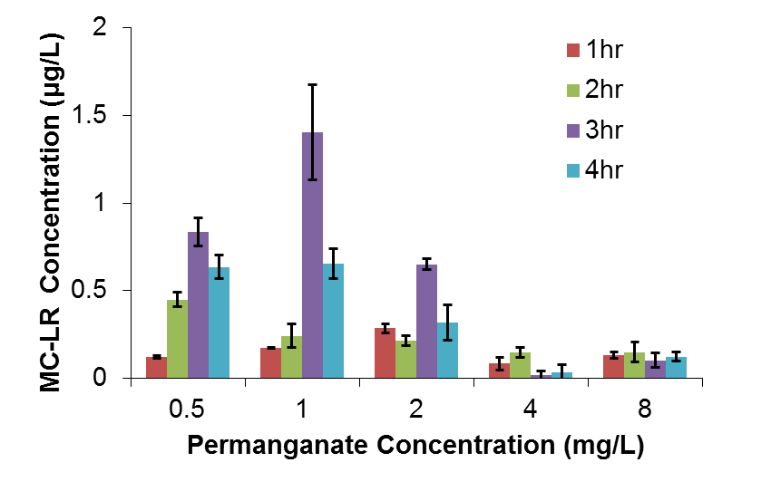
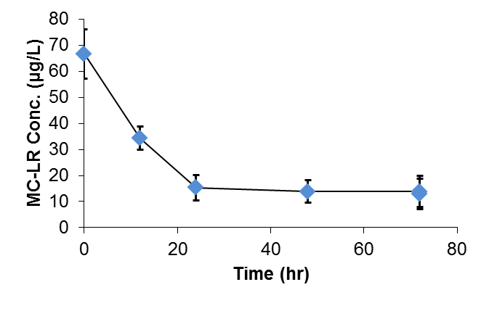
Outcomes to Date
KMnO₄ at a dose of 4 mg/L for 4 hours is the optimal dose and contact time.
Biofilms are capable of reducing toxin concentration by 50% over 12 hours and by 80% over 24 hours

Slide 31
Detection and Quantification of Microcystins by LC-MS
PI: Dragan Isailovic, Associate Professor
Department of Chemistry & Biochemistry
University of Toledo
ODHE Award: Investigation of ELISA and interferences for the detection of cyanotoxins
Award Amount from ODHE: $ 75,011
Matching funds from the University of Toledo: $107,409
Period of Performance: 03/18/2015-03/17/2016

Slide 32
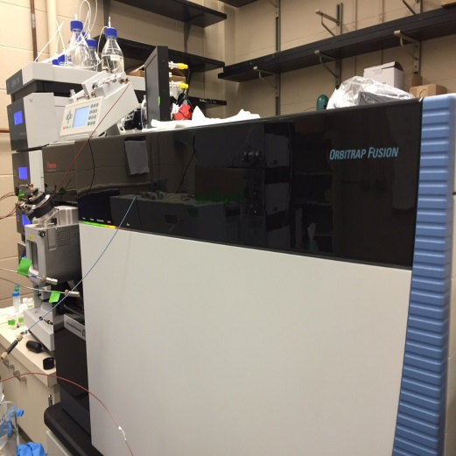
Project Objectives
Focus Area: Detection and quantification of microcystins (MCs) is necessary in order to produce safe drinking water
Challenge: The World Health Organization suggests that MC-LR concentration in drinking water should be < 1 ppb, but accurate detection at these low levels is very difficult.
Our Solution: Develop LC-MS method for quantification of MCs at very low levels
Orbitrap Fusion Mass Spectrometer (MS)
Funding provided by the Department of Defense
(U.S. Air Force Office of Scientific Research) and
the University of Toledo (2014-2015)
Notes:
If needs to be shortened

Slide 33
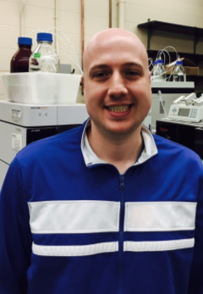
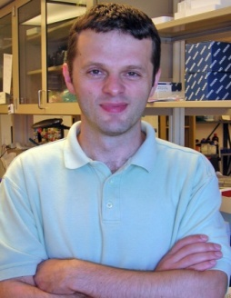
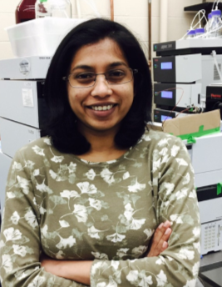
Progress to Date
Our method has improved the limit of quantification of MC-LR to 0.1 ppb (100 ppt) without concentrating the sample and ~0.005 ppb with concentration.
MC-LR is reliably measured in water at concentrations < 1 ppb.
Toxin detection in simple biological samples (PI: Dr. Kenneth Hensley, UT)
Toxin measurements for other UT projects (Bridgeman, Seo)
Future Work
Improve speed and ability to analyze complex water and biological samples.
Raymond West
Dr. Dragan Isailovic
Dilrukshika Palagama

Slide 34
Evaluating Home Point-of-Use Reverse Osmosis Membrane Systems for Cyanotoxin Removal
Glenn Lipscomb, Professor and Chair, Chemical & Environmental Eng.
Youngwoo Seo, Associate Professor, Civil Eng.
$99,328 ODHE
$146,143 UT Match
6/1/16-5/31/18

Slide 35
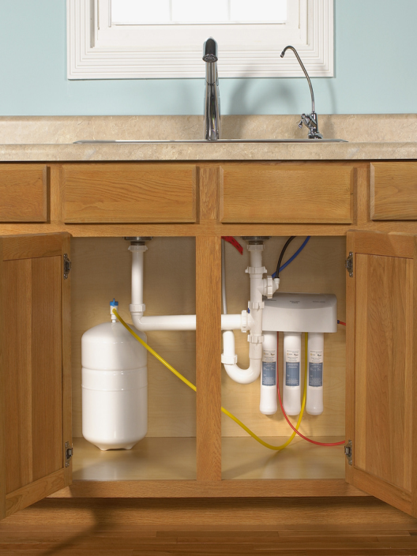
Project Objectives
Overall objective
Demonstrate efficacy of reverse osmosis (RO) membrane separation processes for home applications for removing cyanotoxins from contaminated water
Specific objectives
  Develop a database of home RO products and manufacturers and select test units
  Evaluate effectiveness of microcystin removal
  Evaluate long term removal

Slide 36
Progress to Date
Relationships established with partners
  NSF International – develop performance evaluation protocols, assess aging effects
  Dow Water & Process Solutions – source of membranes and test systems
  National University of Singapore – protocol development and collaboration with Singapore Public Utilities Board (PUB)
Awaiting establishment of research account
Student being recruited to work on project

Slide 37
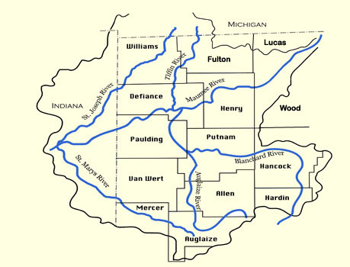
Lake Erie HABs Stakeholders Information Management Project
Dr. Patrick Lawrence, Department of Geography and Planning
Dr. Kevin Egan, Department of Economics
$66,501 (ODHE)
2015-2016

Slide 38
Benefit-Cost Analysis of New Policy Options to Reduce Phosphorous Runoff from the Maumee River Watershed (MRW)
Achieve 40% reduction in phosphorous runoff from the MRW
Policy Option 1: corrective fee on the phosphorous in fertilizer
  $8 cost per acre of farmland in the MRW (Best Management Practices currently cost $14 per acre)
Policy Option 2: Various restored wetlands on available public land
  GIS analysis of available public land in the watershed
    10% Phosphorous reduction: maximum of 2.7% of available public land
    40% Phosphorous reduction: maximum of 10.6% of available public land

Slide 39
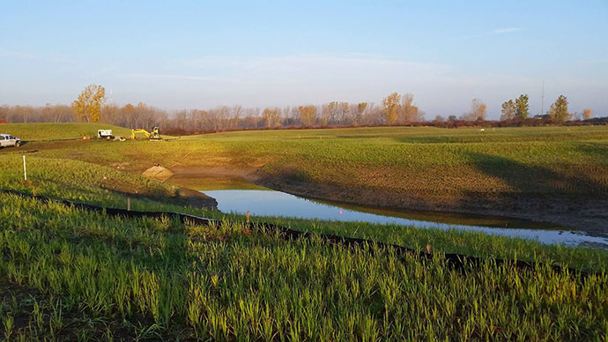

Slide 40

Remaining Questions and Future Work Plan
Recycle any government revenue from fee back to agriculture community
  Lump-sum rebate: majority of farms would benefit from the fee
Complete Benefit-Cost Analysis for wetlands restoration
Same analysis for Combined Sewage Overflow problems

Slide 41
Lake Erie HABs
Information System
How to facilitate informed decision-making by Maumee watershed stakeholders on options to reduce nutrient loadings contributing to Lake Erie HABs
1) Lake Erie HABsIS: searchable database of over 300 sources of information on Lake Erie HABs (by main category and keywords
2) Utilize with Lake Erie Stakeholders (contributions from results of Kent State study of Stakeholder Analysis
3) Provide Policy Options (work of Egan, Economics, UT)

Slide 42


Progress to Date
(Collection of 300+ sources, including PDF of reports/published papers, key contacts, existing web links)
Project website, organized around 5 main categories (Blooms from the Source, Public Health, Land Use Practices, Safe Drinking Water, Economics/Policy)
Searchable database using 40+ different key words, query system allows user to pre-select 3 keywords to search data base
Organization of session at 2016 IAGLR conference
(U Guelph, June 7-10), including presentation on this project

Slide 43
% of Lake Erie HABsIS Materials by Type
# of Lake Erie HABsIS Materials by Main Categories

Slide 44
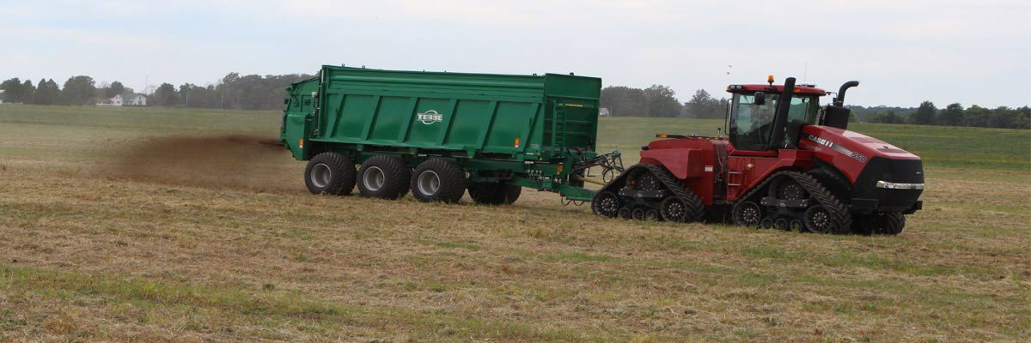
Remaining Questions and Future Work Plan
Release of website and searchable database (Lake Erie HABsIS) – June 2016
Engagement with Maumee watershed Stakeholders
Continued updates of key sources of information to add during Summer 2016 Lake Erie HAB season
Develop dialogue with stakeholders on the policy options to reduce nutrient loadings

Slide 45
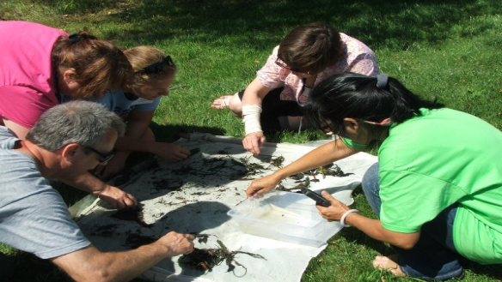
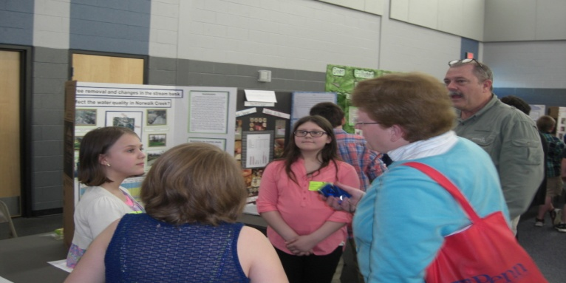
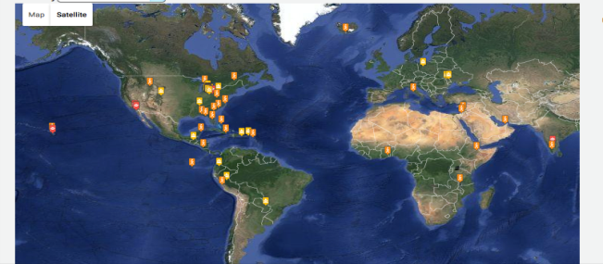

Engagement of the Public Through Citizen Science: Maumee River Watershed
Kevin Czajkowski, Carol Stepien, April Ames
Funding Source: University of Toledo
Provide professional development for teachers on water quality content, testing techniques and research approaches.
Provide students opportunity to present research projects at student conference
Partnering with TMACOG Student Watershed Watch
Partnering with Laura Schetter (Teacher at Wildwood Academy) and her H2yOu.com Project.

Slide 46
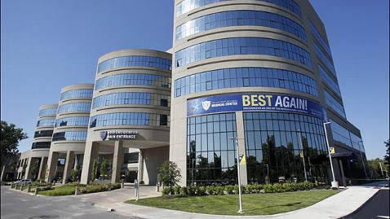

Subcommittee on:
Human Toxicity, Microbiology,
and Public Health
Jason Huntley, Ph.D.
College of Medicine and Life Sciences

Slide 47
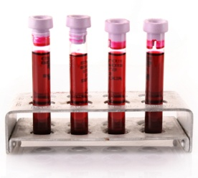
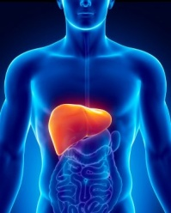

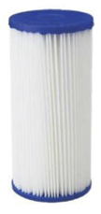
Focus Areas:
1. Detecting microcystin toxins in biological samples
(Ken Hensley – Dept. Pathology)
2. Effects of microcystin toxin on the liver
(David Kennedy – Dept. Medicine)
3. Recreational exposure to cyanotoxins
(April Ames & Mike Valigosky – Dept. Public Health)
4. Microcystin-detoxifying biofilters
(Jason Huntley – Dept. Medical Microbiology & Immunology)

Slide 48
Focus Area 2:
Impact of Pre-Existing Liver Disease on Microcystin Hepatotoxicity
Steven T. Haller, PhD
Assistant Professor, Department of Medicine
David J. Kennedy, PhD
Assistant Professor, Department of Medicine
ODHE Support: $45,000 University of Toledo Matching Support: $45,000
Period of Performance: February-May 2016

Slide 49
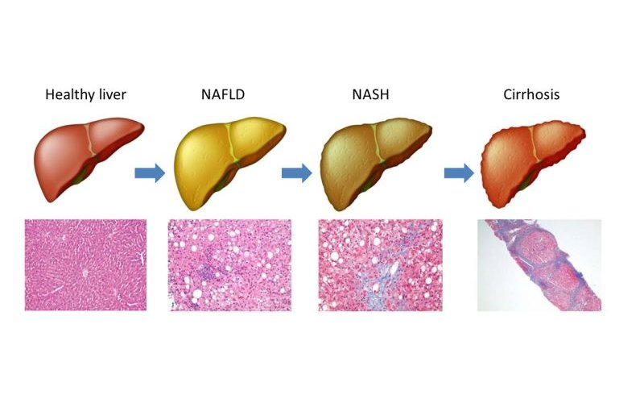
Background:
  Microcystin is a potent liver toxin
  1/3rd of NW Ohioans affected by pre-existing liver disease
    Non-alcoholic fatty liver disease or “NAFLD”
  Effect of NAFLD on susceptibility to microcystin toxicity is unknown
Objective:
  Create animal models of pre-existing liver disease and expose to microcystin
  Perform toxicology studies to define this susceptibility
Microcystin?
Notes:
• Liver disease is progressive and may involve multiple “hits”
• MC-LR may be one of the hits that pushes the disease towards NAFLD
• NAFLD is more severe and associated with higher morbidity and mortality

Slide 50
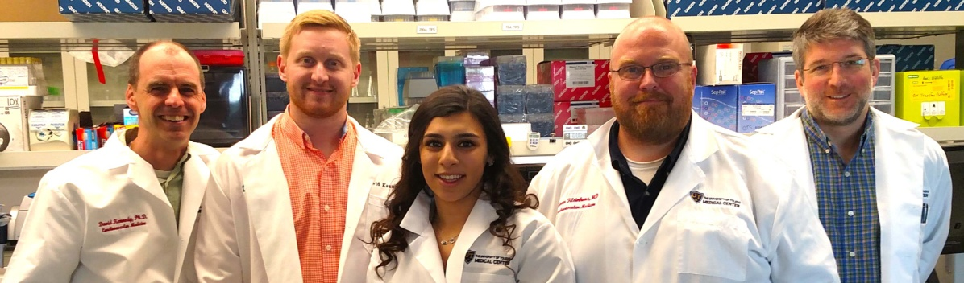
Progress and Future Work:
Are subjects with liver disease more susceptible to microcystin?
  Create diagnostics tests to measure microcystin levels and toxicity
  Establish guidelines to help protect these at risk populations
How does microcystin damage livers?
  Identified enzyme (PON) which may combat microcystin induced liver injury
  Further studies needed to determine if PON can be a target for therapy
Collaborate and leverage these studies into NIH support
Notes:
1) These animal models are the first steps which will allow us to address whether “At-risk” subjects with pre-existing liver disease are more susceptible to liver damage by MC.
Along these lines we are actively collaborating with the other experts funded by the Sea Grant to develop diagnostic tests which will allow us to measure MC blood levels and monitor its toxicity in humans. There is currently no test to measure this in humans, so this will be a tremendous advancement/product (example of being able to do a differential diagnosis on ER patient with exposure from Lake Erie). This information will also allow us to publish evidence based human health guidelines specific for at-risk populations (there are currently none).
2) Importantly we are actively investigating the mechanisms by which MC injures the liver and have identified an enzyme called “PON” (paraoxonase) which is decreased in the mice with liver disease and may be needed to combat MC induced liver injury. Further studies will be needed to see if strategies to augment PON will help protect this vulnerable population from MC injury
3) Collaboration are underway both within UT and with other Sea Grant investigators to leverage these Sea Grant funds into NIH supported human research studies

Slide 51
Focus Area 3:
Characterization of Recreational Exposures to Cyanotoxins in the Western Lake Erie Basin
April Ames, Michael Valigosky, Brian Fink, Barbara Saltzman
Department of Public Health
Project Partner: Toledo-Lucas County Health Department
ODHE Support: $21,213 University of Toledo Matching Support: $54,655
Period of Performance: April – May 2016

Slide 52
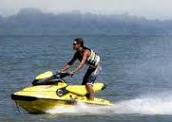
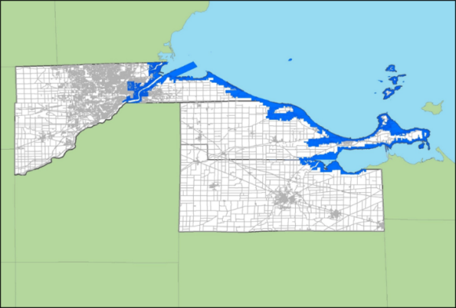
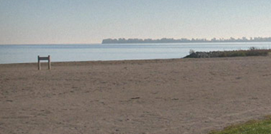
Objective:
Survey recreational and occupational users of Lake Erie in Lucas, Ottawa and Sandusky counties
  Frequency, duration, exposure route(s)
  Geographical areas of use
  Activities for future air sampling
Pilot sampling of airborne microcystin for future phases
Future work, if funded, would examine exposure and risk of recreational and occupational populations, including collection of air samples during activities generating aerosols and prospective cohort study

Slide 53
Focus Area 4:
Development of Microcystin
Detoxifying Water Biofilters
Jason Huntley, Ph.D.
Department of Medical Microbiology and Immunology
ODHE Support: $55,000 University of Toledo Matching Support: $78,740
Period of Performance: March 2015 – June 2017

Slide 54

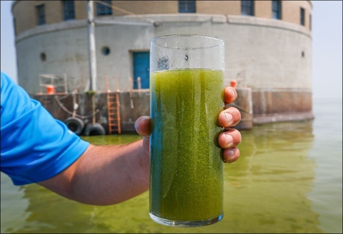
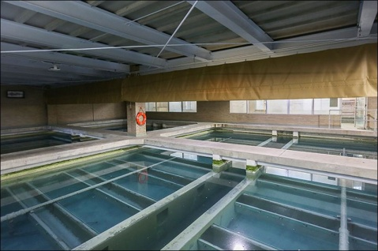
Objectives:
Isolate naturally-occuring MC-LR-degrading bacteria from Lake Erie
Develop biofilters that efficiently and cost-effectively remove MC-LR from our drinking water
Expected Outcomes/Products:
Provide MC-LR-degrading bacteria to City of Toledo Water Treatment Plant to form biofilms on existing filters/treatment processes
Notes:
Current microcystin (MC-LR) removal processes triple the cost of water treatment, result in hazardous waste, and generate toxic by-products

Slide 55


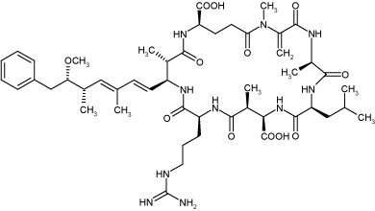
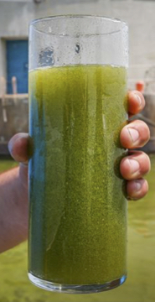

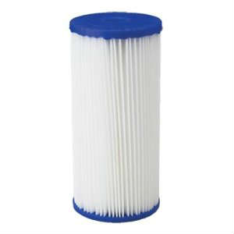
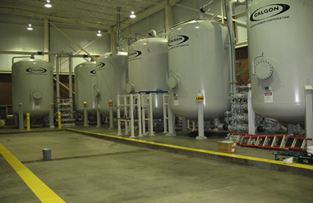



Rationale:
Ala
Glu
Adda
Ala
Leu
Asp
Arg

Slide 56



Progress to Date:
Biofilm testing
Individual clones
+MC-LR
Start
End
neg
pos

Slide 57





Ongoing Studies and Future Plans:
Evaluating biofilm formation and MC-LR removal on powdered activated charcoal (PAC)
Laboratory-scale MC-LR water filtration
Work with City of Toledo Water Treatment Plant to develop biofilter feasibility plans
Second Round ODHE funding: Discover enzymes and pathways of MC-LR degradation

