Slide 1
Writing Effective Job Descriptions
HR Compensation
February 2022

Slide 2
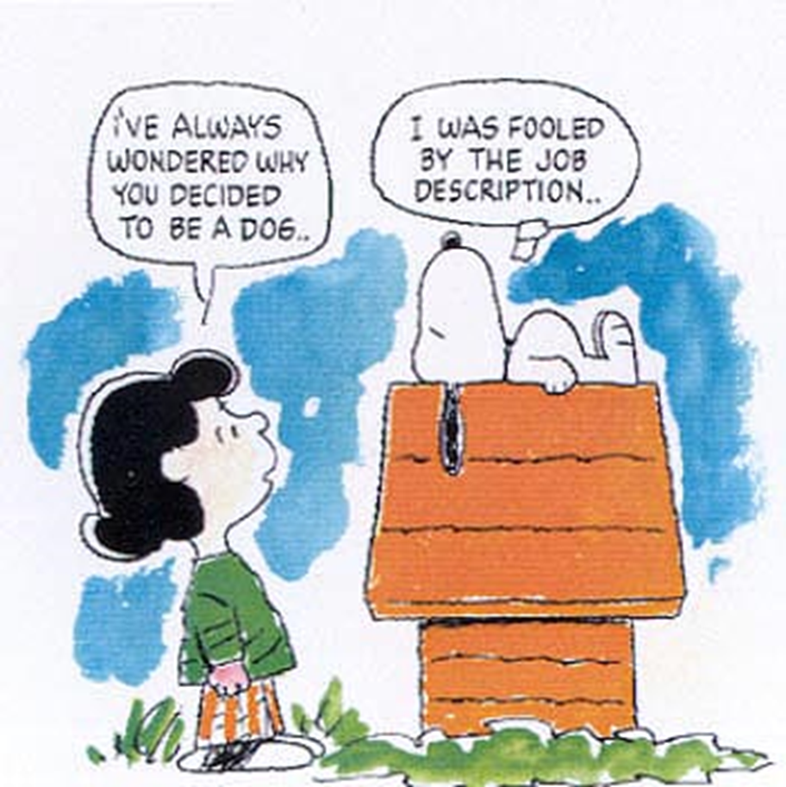

Slide 3
DEFINITION:
A job description communicates a position’s:
Purpose
Essential duties
Required Qualifications
knowledge, skills, and abilities necessary for the job and
Direct reports and supervision
Physical requirements to employees and supervisors, HR, prospective applicants, and others.

Slide 4
job descriptions clarify WHO is responsible for WHAT within your organization

Slide 5
job descriptions are used to:
Advertise and recruit for vacant positions
Conduct performance evaluations
Determine appropriate pay
Determine working accommodations (Americans with Disabilities Act-1990)
Inform employment/performance management plans
Inform Workers’ Compensation cases
Determine appropriate medical leave (Family and Medical Leave Act-1993)
Determine Equal Employment Opportunity Commission coding

Slide 6
A job description is NOT
A description of the job holder
A procedure manual
An employment contract
A finite representation of the job
The only thing that determines a job classification
A one-time project

Slide 7
A job description is only valid to the extent that it ACCURATELY reflects the job content.
Keeping job description’s up-to-date should be an ongoing goal for every supervisor.

Slide 8
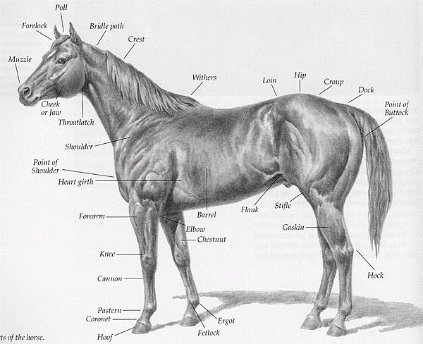
Anatomy of a job description

Slide 9
Sections of the job description:
General summary of the position
Duties and Responsibilities
Required qualifications of the job
KSA’s- Knowledge, Skills and Abilities
Reporting Relationships
Physical and mental working conditions of the position

Slide 10
General Purpose Summary
This section, should be limited to a few sentences describing the reason the position exists.
TIPS:
Use clear, concise language.
Use active voice (Complete the sentence, “This position exists to…”)
Stick to the basic purpose of the position and steer clear of KSA’s, organizational structure, and other extraneous details.

Slide 11
Essential Duties and Responsibilities
In this section, list the major job duties in descending order of importance, the percentage of time spent on them and whether or not they are essential to the position.
Ask:
1) Does the position exist to perform this particular job function?
2) Would removal of this job function fundamentally alter this position?

Slide 12
Essential Duties – Four Principles
Essential duties should be a series of brief statements which summarize the most significant duties or activities which the person is responsible for performing on a regular basis.
The duties and responsibilities section is not intended to resemble a “procedures manual” or to cover every possible combination or variation of procedure followed.
The descriptions should be written in active voice and it is best to avoid specific dollar amounts, quantities, operating systems, software, or other aspects of the job that may change frequently.
The word “manage” should only be used when the duty involves managing people.

Slide 13
Qualifications and KSAs
Provide the minimum education and years of direct experience the candidate will need to fulfill the requirements of the job.
This includes mandatory licenses and certificates.
Provide a list of the foremost knowledge, skills and competencies the candidate will need to have to enter this job.
Example:
• Good written and verbal communications required.
• Critical thinking for creation of logic relative to system programming.
• Effective decision-making and problem-solving skills required.
• Must be detail-oriented and have ability to keep organized and accurate records.

Slide 14
Reporting Relationships
In addition to the job’s direct supervisor, indicate the titles of other positions which provide work direction to this position.
Also, indicate which positions report directly to this position, as well as other positions that receive work direction from this position.
Some single incumbent jobs will allow this section to be specific, while jobs that have several positions that share the same description and title, will be more generic.

Slide 15
Working Conditions
Working conditions are the usual physical surroundings or other normal working conditions for the job.
Indicate the type of location for the job and the environmental conditions the position is exposed to and how often. Indicate what machines/tools must be used and how often.
Example:
Works in a professional office environment with possible high stress levels. There is a lot of noise and activity in the area which causes distractions.
The nature of this position involves a large number of interruptions for questions from departmental staff and other university personnel so ability to concentrate is sometimes challenged. Ability to lift 25 pounds is required to move and install equipment.

Slide 16
Conclusion
It is not realistic to expect to produce perfect job descriptions. Good writing is often a matter of trial and error.
Go ahead and get some information down, leave it, then return to it, modify, and then leave it again.
Work towards it being easily read and understood. Simplicity is a good thing.
It is easier to maintain objectivity if the document has been edited and revised several times.
Invite someone with “fresh eyes” to review your work and provide feedback.

Slide 17
When in doubt, contact your HR Compensation staff.
We are here to help!!

