Slide 1
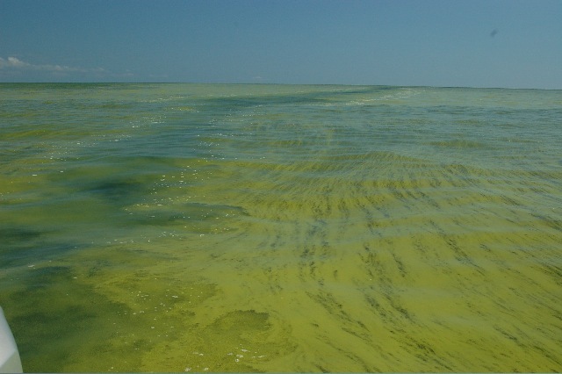








Harmful Algal Blooms in Western Lake Erie
Thomas Bridgeman, University of Toledo
March 16, 2012

Slide 2
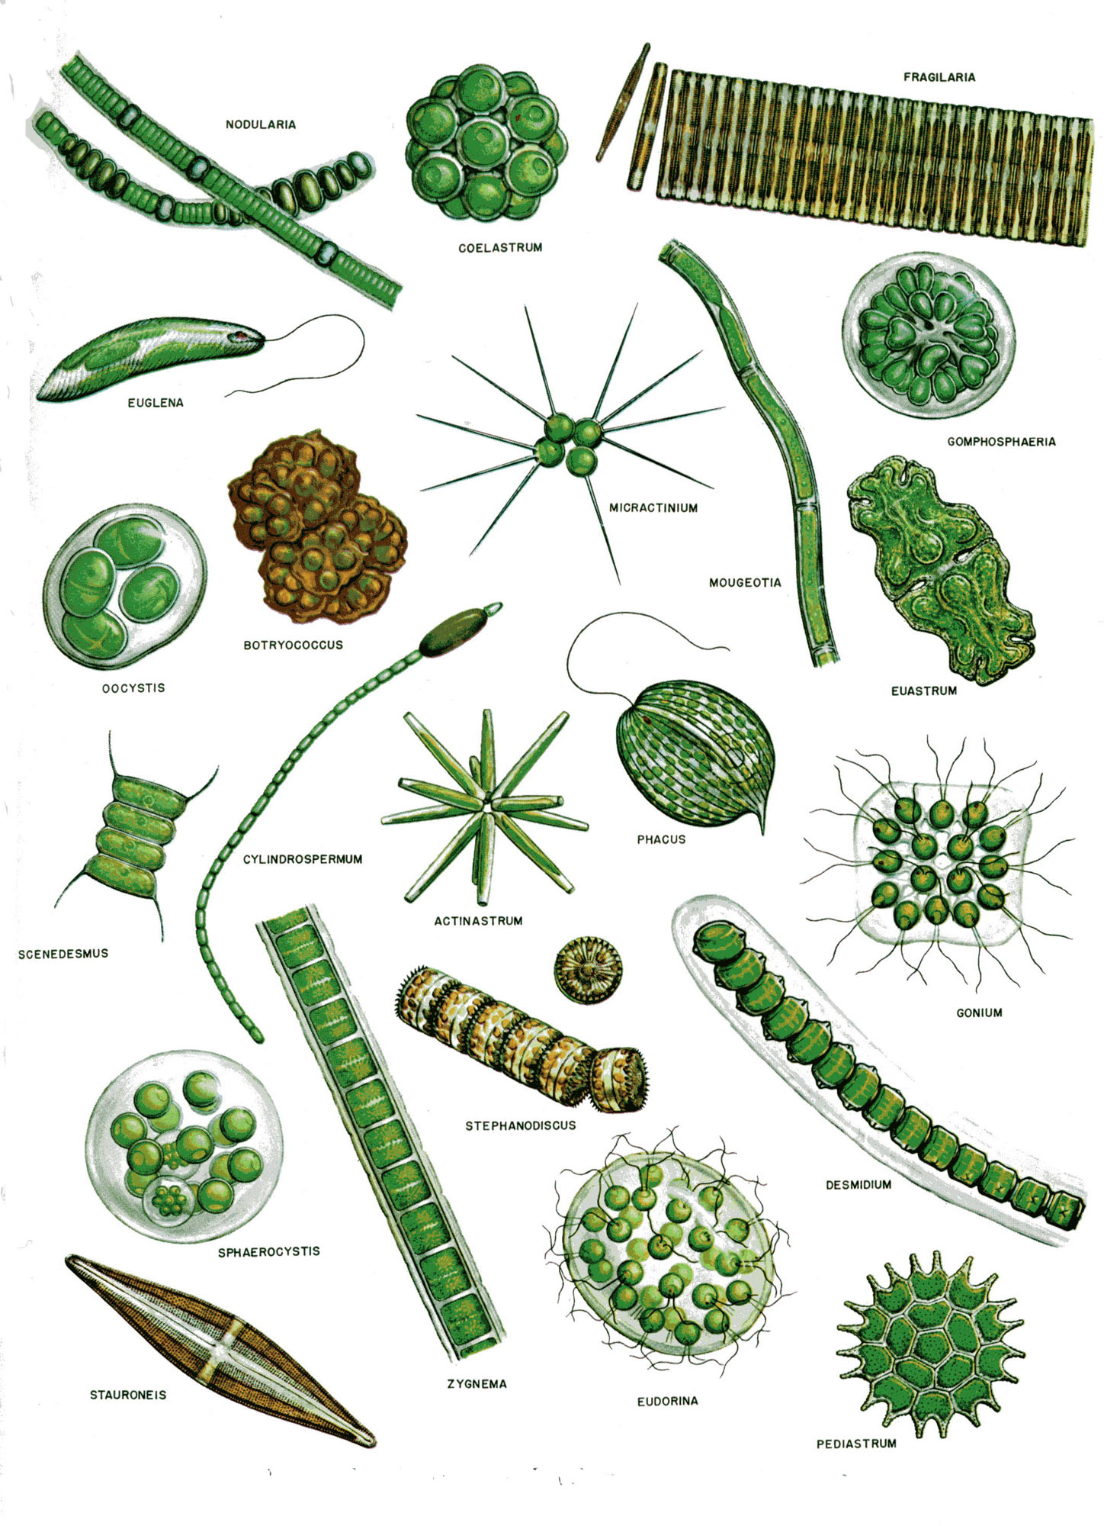
Algae are tiny plant-like organisms that live in water
There are hundreds of species of algae in Lake Erie.
Most are beneficial.

Slide 3
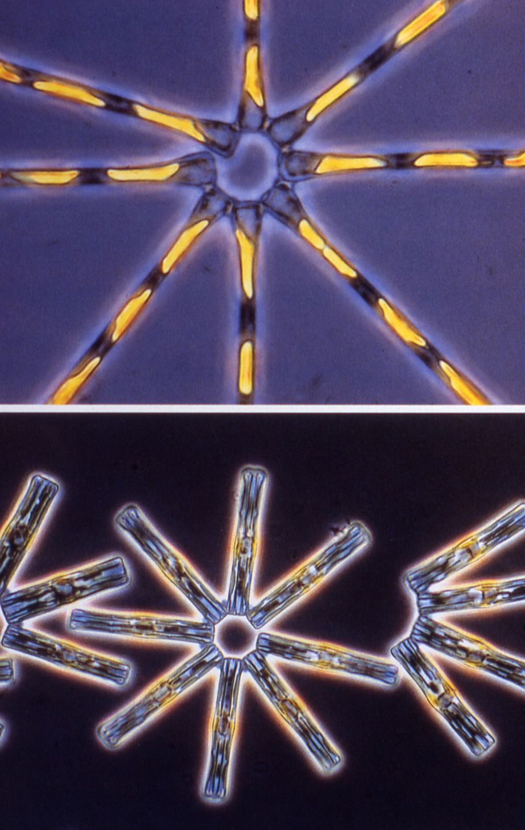
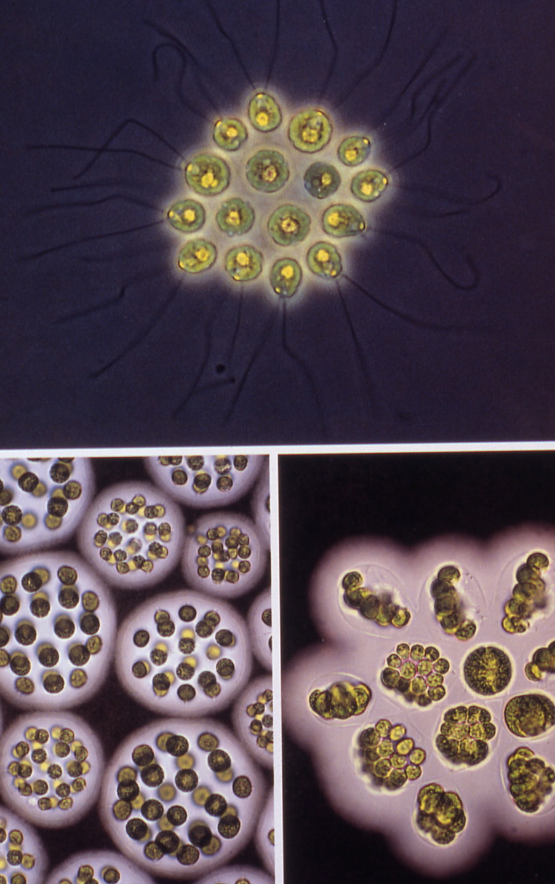
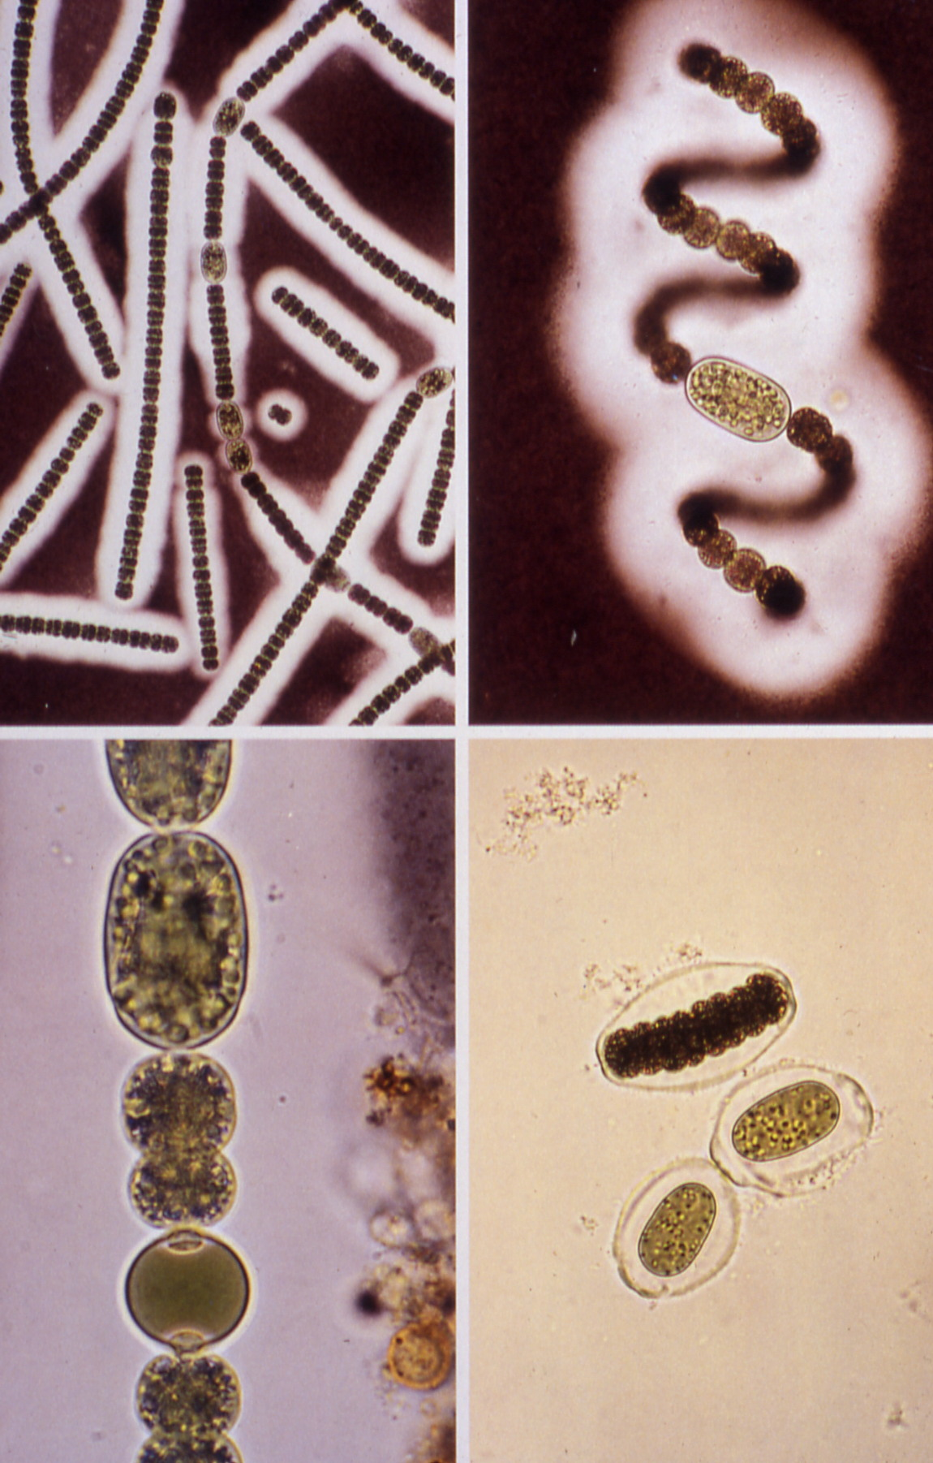
Major groups in Lake Erie
Diatoms
Greens
Blue-greens
(Cyanobacteria)
Notes:
Mention summer blooms of diatoms, taste and odor issues

Slide 4
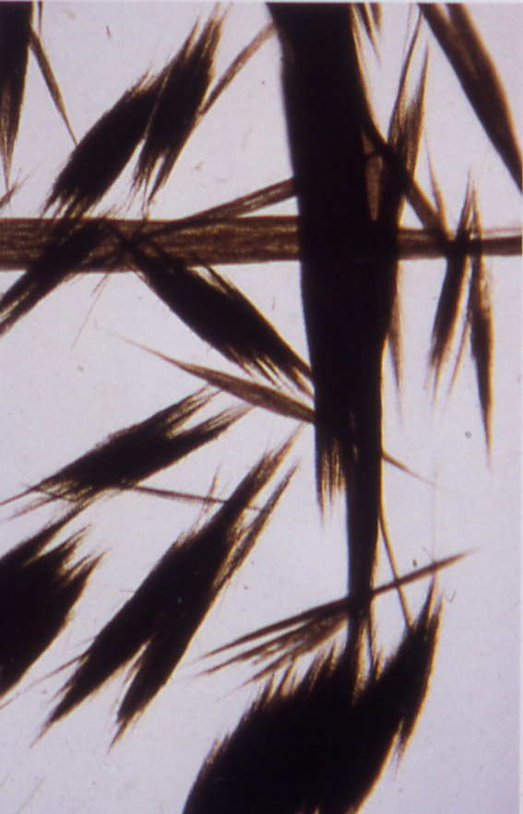
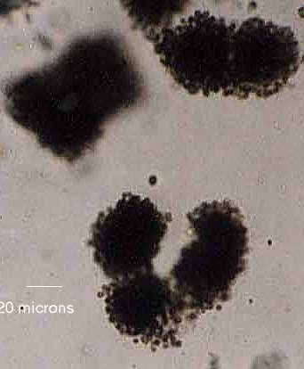
Cyanobacteria in Lake Erie
Anabaena
Aphanizomenon
Microcystis
Notes:
We’ve always had all 3 but for some reason, MC has become the dominant BG and has recently produced large blooms in the lake.

Slide 5
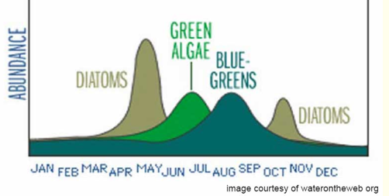
Factors leading to cyanobacteria blooms
Seasonal patterns
  -Late summer is cyanobacteria season.
  -Climate Change: What would be the effect of an extended summer?

Slide 6
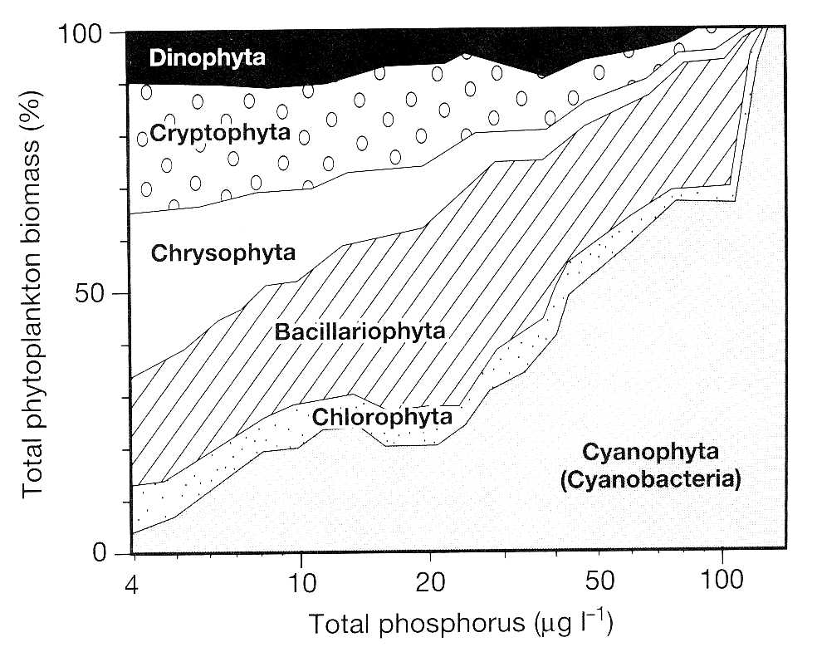
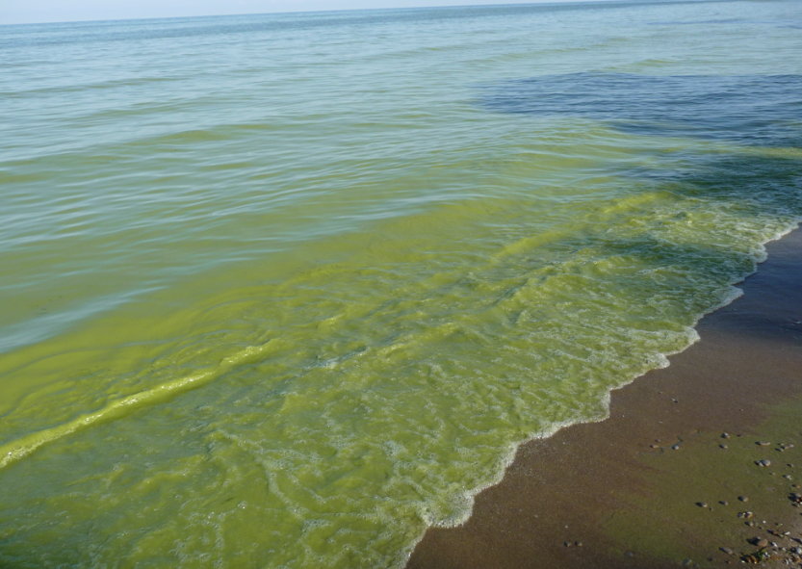
Factors leading to cyanobacteria blooms
Phosphorus concentration
  -High P concentrations result in dominance by cyanobacteria
(Kalff 2001)

Slide 7
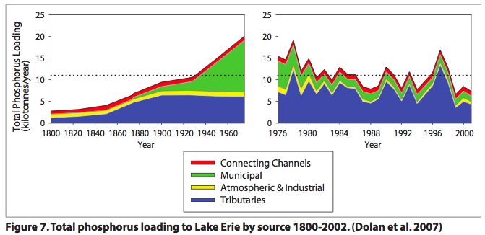
Eutrophication of Lake Erie

Slide 8
Eutrophication of Lake Erie
Between1920 and 1964 Lake Erie algae biomass increased nearly 6 fold.
Diatoms replaced by cyanobacteria.
Harmful algal blooms led to passage of the GLWQA
1920
1964
Davis 1964

Slide 9
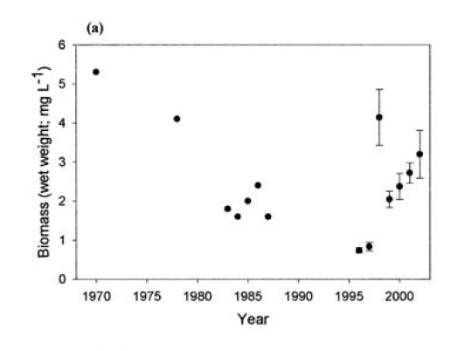
Recovery and recent return to eutrophic conditions
Algae
Conroy & Culver 2005

Slide 10
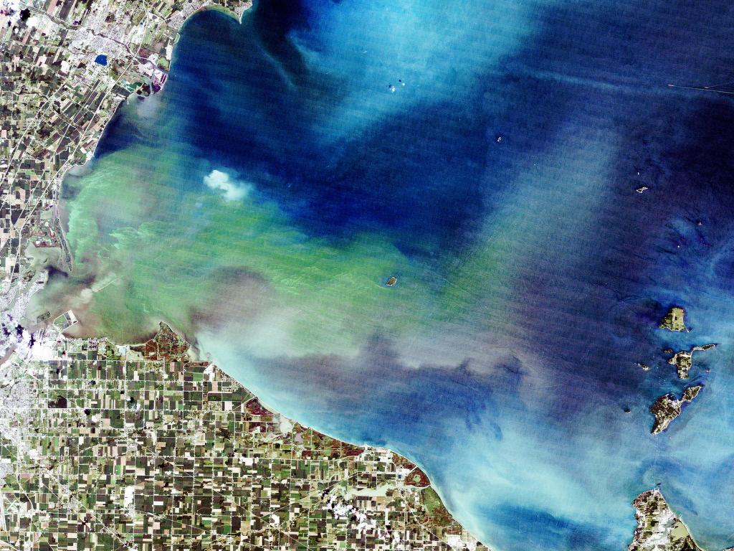

Microcystis bloom
August 2003
Toledo Water Intake
OhioView

Slide 11
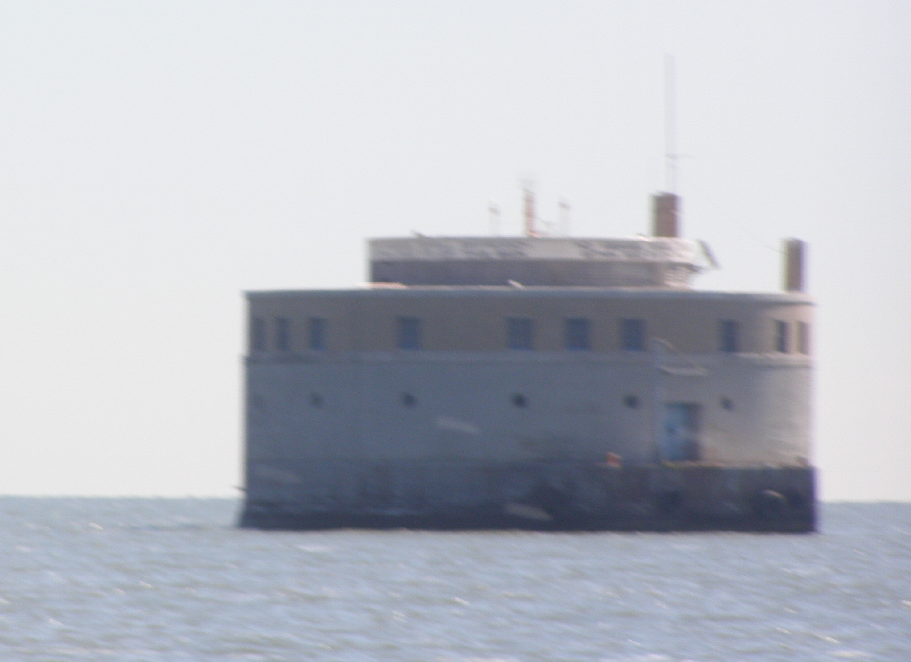
Why should we care?
Harmful Algal Blooms produce toxins
  Microcystis produces microcystin
    Fatal poisonings in Brazil 1988, 1996
    Pets poisoned in the USA
  Rotten smell, fouled beaches – public perception of lake as polluted.
  Contribute to central basin Dead Zone
  Economic cost, additional $3K-$4K/day water treatment
  Harmful to sport fish recruitment ($1B fishery)

Slide 12
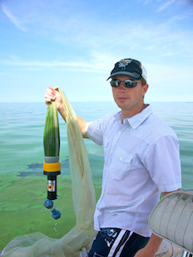
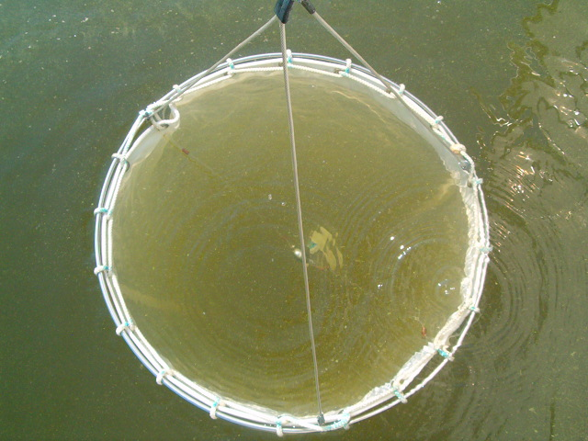
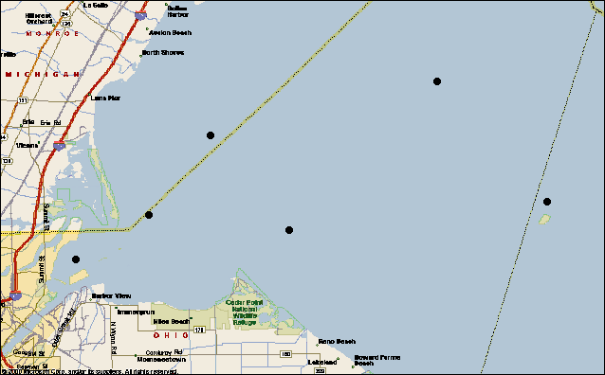
Field Methods (2002-2011)
6 sites sampled biweekly
112 um mesh plankton net
Nutrients
West Sister
Island
Maumee Bay

Slide 13
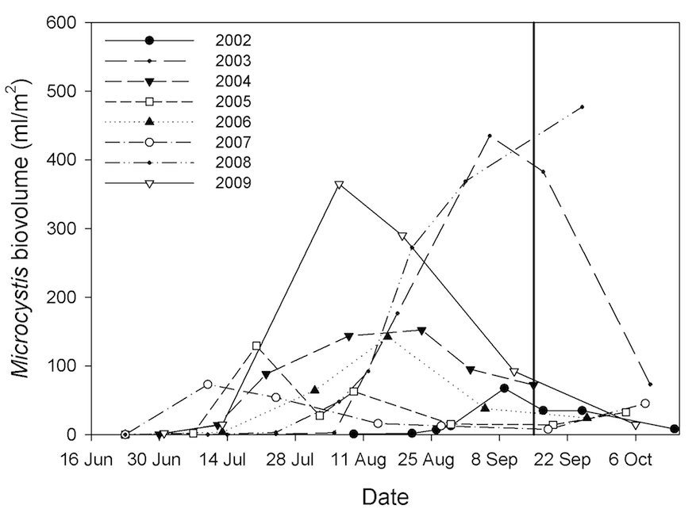
Annual estimate of Microcystis
2009
2002

Slide 14
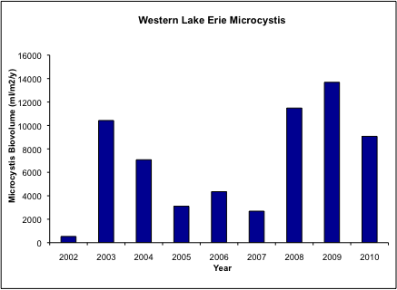
Microcystis in Lake Erie
The Microcystis-Anabaena bloom of 2009 was the largest in recent years in our sampling region
…until 2011
2011

Slide 15
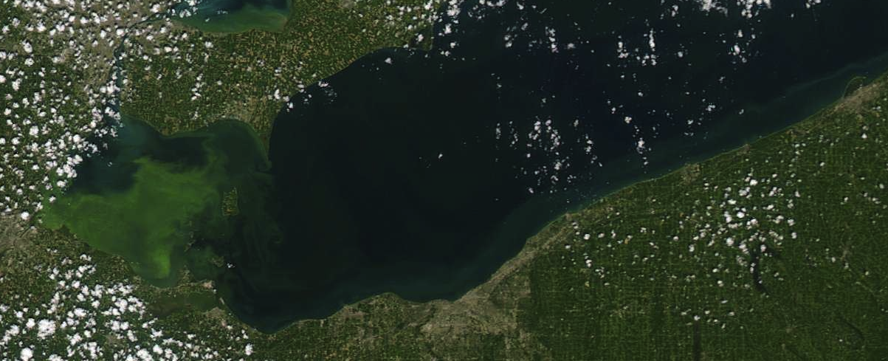
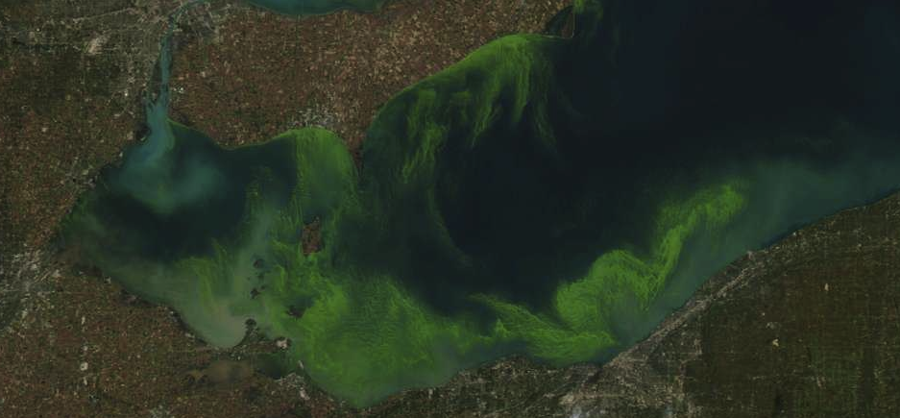
Bloom of 2011
Large Bloom in the Western Basin, followed by a large bloom in the Central Basin or Lake Erie.
Was it the same stuff just transported to the east?
Or was it new growth, fertilized by different sources?
August 11 2011
MODIS images
October 7 2011

Slide 16
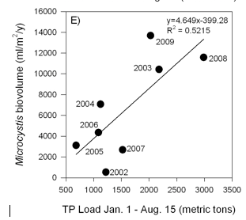
What accounts for the large interannual variation in Microcystis blooms?
-What is the effect of Maumee River P loading?
The best predictor of Microcystis annual crop is the cumulative TP load from the Maumee River from January to August.

Slide 17
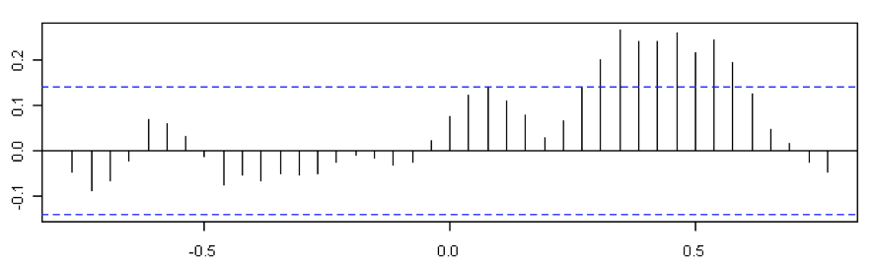
What accounts for the large interannual variation in Microcystis blooms?
-What is the effect of Maumee River P loading?
Time series analysis, 2002-2009
Summer Microcystis is somewhat correlated to Total P loading 4-6 months earlier
Correlation Factor
Year

Slide 18
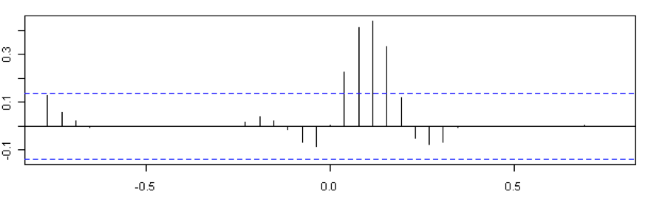
Phosphorus load vs. Microcystis time series analysis
2002-2009
What accounts for the large interannual variation in Microcystis blooms?
-What is the effect of Maumee River P loading?
Summer Microcystis is highly correlated to Dissolved Reactive P loading 4-8 weeks earlier
Correlation Factor
Year

Slide 19
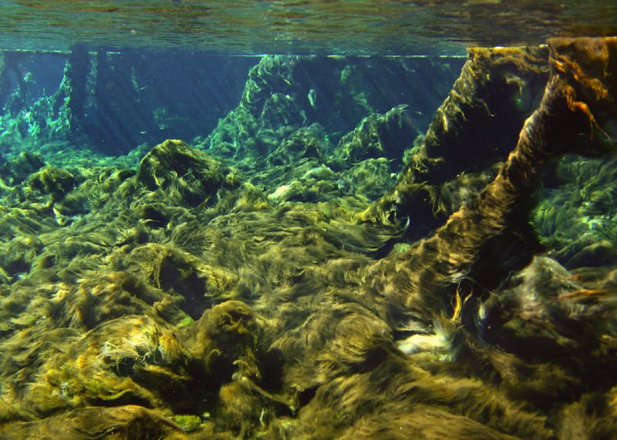
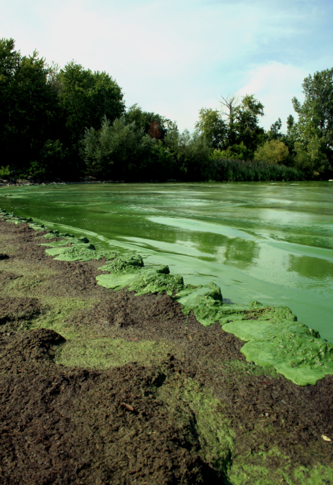
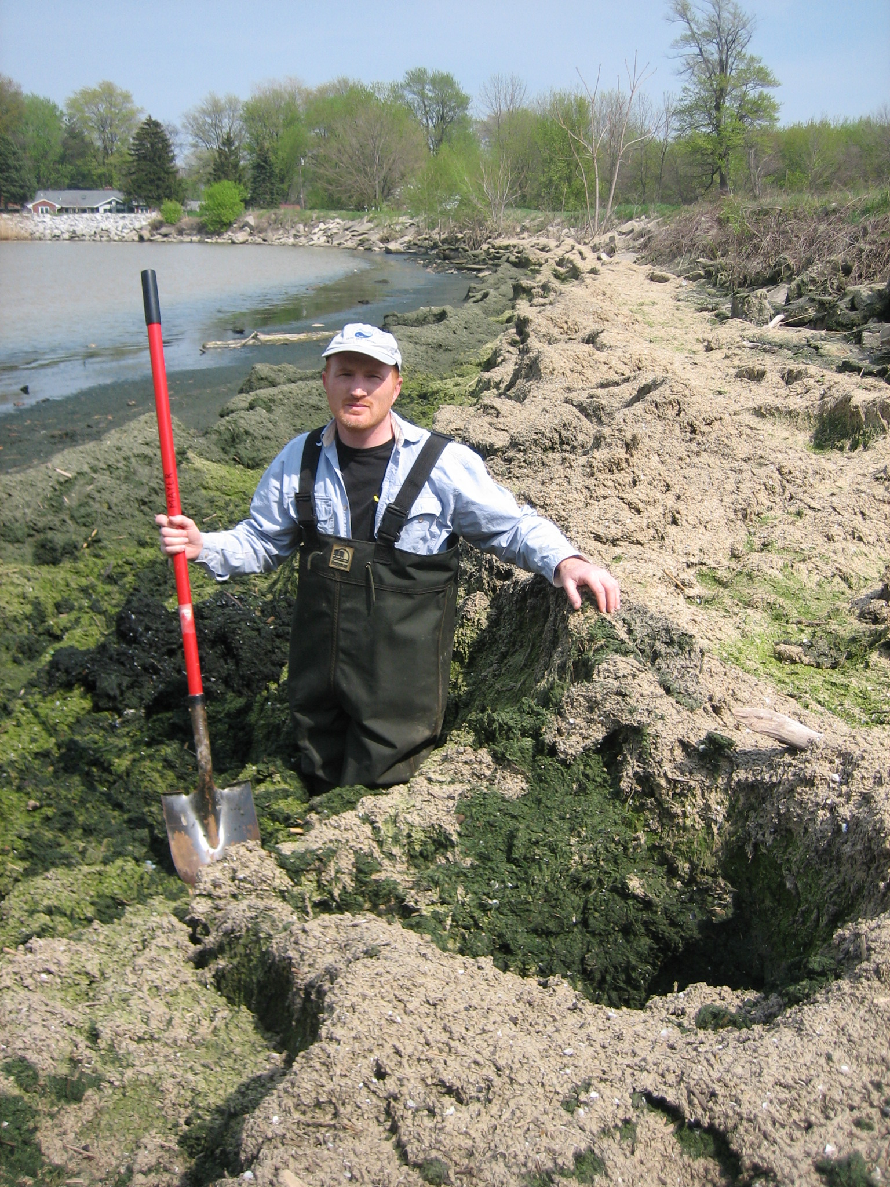
Lyngbya wollei, a new nuisance cyanobacterium in Lake Erie

