Slide 2
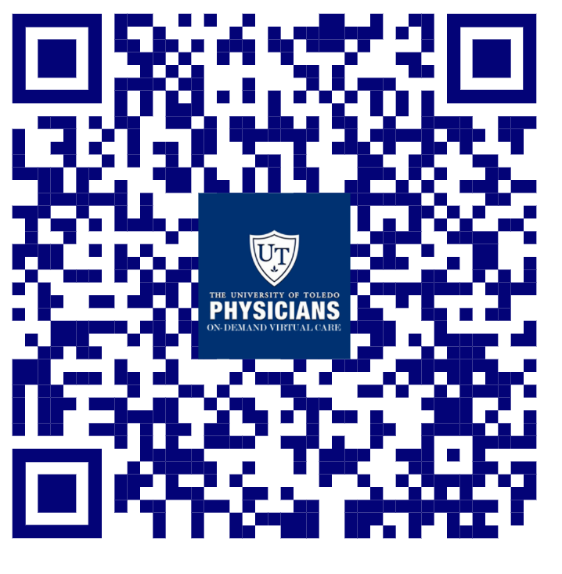
Virtual Urgent Care
Advantages of Using Telemedicine vs ER
Dr. Kris Brickman
09/11/2020

Slide 3
Virtual Urgent Care
Urgent Care, Telemedicine and Emergency Care
Urgent care is for injuries and illnesses that are non-life threatening and require care fast.
These illnesses or injuries may necessitate follow-up with a primary care provider or specialist
Our goals is to get the patients the access they need and the connections to primary care providers or specialists for follow-up.
Emergency Care is for serious medical conditions when delay could cause permanent harm or death.
Often times the community uses the ED for healthcare when they don’t have a place to turn.

Slide 4
Virtual Urgent Care
ED Overuse and Access Challenges
The ED is commonly used to combat access issues
Merritt Hawkins released a study that found
Americans wait on average 24 days for a new primary care appointment
Personal challenges- transportation or lack of insurance cause patients to choose the ED
Some patients use the ED for common complaints and are not advised of alternative care options, increasing the ED use rates.
The most recent National Report Card on the State Emergency Medicine rated Emergency care access in the US a D-.
The solution is Virtual on-demand access

Slide 5
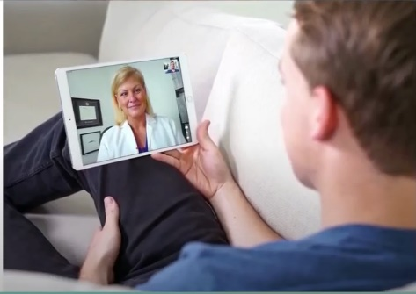
Virtual Urgent Care
UTP Telemedicine Center
University of Toledo Physicians has over 50 primary care physicians and 250 specialist whose focus is providing high-quality care to every patient. UTP has a personal connection and interest to improve the health of the UToledo community.
On-Demand Telemedicine is integral to the future of the way we provide care in order to lower costs as well as increase access and quality. Patients are now able to access right from their computer, tablet or smartphone via online portals or applications, rather than spending time in the Emergency Department or Urgent Care Clinic.

Slide 6
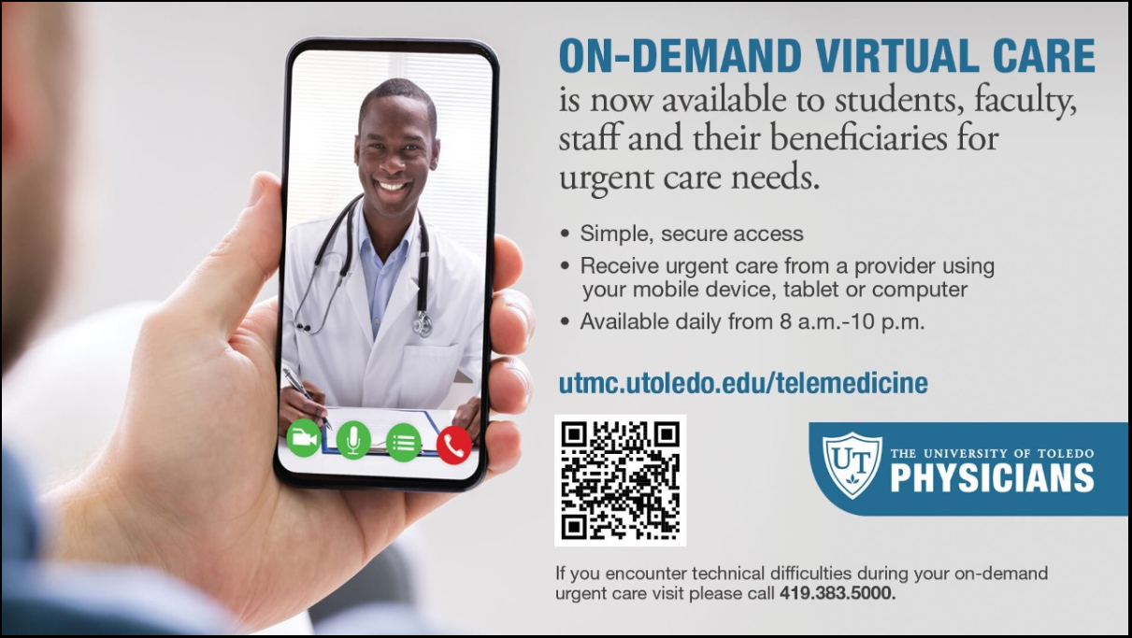
Virtual Urgent Care
UTP Telemedicine Center
The University of Toledo Physicians is currently offering expanded access to on-demand telemedicine services by emergency medicine trained providers.
Providing commitment to quality, decreased cost and patient-centered care.
This on demand service is convenient, secure, and will meet the access needs of the Faculty, staff, beneficiaries, and students by providing contact to health care providers quickly.

Slide 7
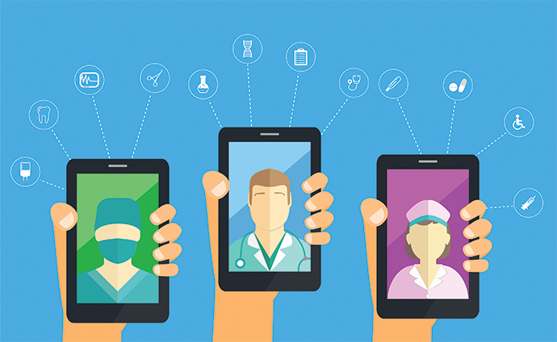
Virtual Urgent Care
UTP Telemedicine Center
Advantages of Telemedicine Urgent Care
Access Hours 8am- 10pm (Phase I) and then 24-7 ( Phase II)
Easy
Comfortable Connect from the ease of you home, or anywhere
Familiar Established patients can request follow-up visits with
providers in their regular clinic.
Affordable Lower out of pocket costs for UToledo insured
Referral Internal referral system for continuity of care

Slide 8
Virtual Urgent Care
UTP Telemedicine Center
SERVICES
BENEFITS
COST
Acute non life- threatening conditions
Headache/ Infections
Sore throat/ Sinus Infection
Ear Ache/ Headache
Depression/ Anxiety
Sprains/ Strains
Pink Eye/ Rash
Vomiting/ Diarrhea
Flu like symptoms
Anxiety/Depression
Other additional non-life threatening conditions
Ease of access to consistent medical care
Payer blind
Improve the health of the community
Convenience
UT Insurance regardless of plan.
UT Health Insurance Plan Coverage
Paramount, Medical Mutual, & Front Path
Co-Pay, Deductible & Co-Insurance will apply
Self-Pay or No-Insurance $59
All other insurance will be billed and we will bill you your financial responsibility co-pay, deductible and co-insurance applies

Slide 9
Virtual Urgent Care
UTP Telemedicine Center
As part of your community, University of Toledo Physicians is the best choice for your remote health care needs. Implementing virtual on-demand care will:
Reduce non-emergent care in the ED,
Reduce ED wait times for those in need of emergent care,
Re-direct non-emergent cases to a more appropriate and cost- effective level of care.
https://visitnow.org/utoledo/select-a-service

Slide 10
Virtual Urgent Care
UTP Telemedicine Center
Thank You

